Slide 1
Homework Check-School to Home (page 35)
1. Possible answer: How are the bone cells in a human structured differently from muscle cells?
2. Possible answer: I know muscle cells have a long, thin shape. Muscle has to be flexible. I think bone cells have a different shape because their tissue has to hold its shape more than muscle does.
3. Possible answer: I will get slides of muscle cells and bone cells. I will look at them under a microscope and compare how the cells are shaped
4. Possible answer: I will make a sketch of muscle cells and bone cells at 100× magnification. Then I will sketch each type of cell at 400× magnification.
5. Possible answer: The slides for these two types of cells might not be available. I could compare muscle cells to another type of cell instead

Slide 2
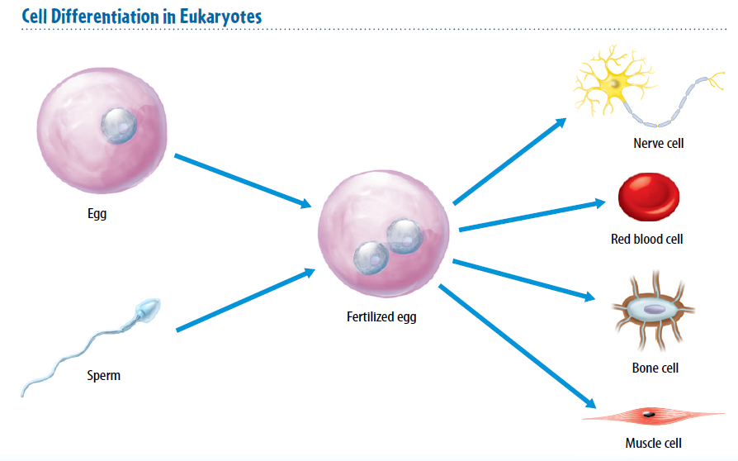
1/11/18 Thursday 5 minutes Draw and write the name

Slide 3
Today Agenda
1) Homework Check/ Bell Ringer 5 minutes
2) Key Concept Builder 15 minutes
3) Content Practice (A-B) Independent Practice-10 minutes
4) Natural Selection (Reading Passage) 13 minutes
5) Homework (Bos/Umad/Texas)

Slide 4
Key Concept Builder (page 36)
1. B
2. U
3. M
4. U
5. M
6. M
7. M
8. M
9. A prokaryotic- without nucleus/ eukaryotic has nucleus.
10. A unicellular one cell carry all activities, multicellular has system to do it.

Slide 5
Key Concept Builder (page 37)
1. cell; the smallest unit that makes up all living things
2. tissue; a group of similar cells that work together to carry out a specific task
3. organ; a group of different tissues working together to perform a particular job
4. organ system; a group of different organs that work together to complete a series of tasks
5. organism; a living thing that can be made of different organ systems

Slide 6
Key Concept Builder (page 38)
1. A stem cell is an unspecialized cell that is able to develop into many different cell types.
2. Cell differentiation is the process by which cells become different types of cells.
3. Stem cells in an embryo are important because they develop into every type of cell that the organism needs.
4. Adult stem cells are important because they allow for cell repair and replacement.
5. In people, adult stem cells are in bone marrow and skeletal muscles.
6. In plants, unspecialized cells are grouped in areas called meristems.
7. The chromosomes in a skin cell and a muscle cell in the same organism are identical. The cells are different because each cell type uses different parts of the instructions on the chromosomes.

Slide 7
Key Concept Builder (page 39)
1. The four main types of tissues in humans are muscle, epithelial, nervous, and connective.
2. The three main types of tissues in plants are dermal, vascular, and ground.
3. The stomach and a leaf are organs that are made of different types of tissues.
4. The human circulatory system and a plant’s shoot system are organ systems that transport materials throughout the organisms..
5. Multicellular organisms have more than one organ system because each organ system has specific tasks.

Slide 8
Content Practice A-B
You have 10 minutes to finish to classwork. It will be graded.

Slide 9
Content Practice B
Unicellular one cell, Multicellular is more than one.
Unicellular organisms carry all activities one cell.
Multicellular is specialized cell carry different jobs 3. Cell differentiation is the process by which cells become different types of cells.
4. Stem cells are unspecialized cells and are the only type of cell that can develop into different types of cells.
5. Cells-Tissue-organ-organ system-organism

Slide 10
Natural Selection
https://www.ck12.org/c/life-science/natural-selection/lesson/Natural-Selection-MS-LS/

Slide 11
Homework (Umad/Texas/Bosphrous)
Lesson 2 Levels of Organization

