Slide 1
Warm Up 1-13-17 5 minutes
1)What is common ancestor?
(Homework question 10)
A)An animal that has a lot of offspring
B) An animal that is related to many other species
C) An animal from which two or more different species evolved.
D) An animal that’s good at escaping from predators.

Slide 2
Answer
What is a common ancestor?
An animal from which two or more different species evolved.
1) B 6) A
2) C 7) A
3) B 8)A
4) D 9)B 5) C 10)C

Slide 3
Today Agenda
1) Warm Up 5 minutes
2) Open Notebook Quiz 10 minutes
3) Activity Survival the fittest 20 minutes on chromebook.
4) Kahoot. 10 minutes (last 10 minutes)
5) Study Guide (Chapter Test 1-20-17 Friday)

Slide 4
Activity
http://www.glencoe.com/sites/common_assets/science/virtual_labs/LS06/LS06.html

Slide 5
Study Guide
1) Gregor Johann MENDEL was an Austrian monk and biologist whose work on heredity became the basis of the modern theory of genetics. He work on genetic by using pea plants. He is known for Father of genetics

Slide 6
Study Guide
2) What is allele?
Answer; One of the several possible forms of genes.
An alternative form of gene that may be dominant or recessive.
A person with red hair compared to a person with blonde hair they have different alleles.

Slide 7
Study Guide
3) Place in order from smallest to largest.
Gene<DNA<Chromosome
Gene: A segment of DNA that codes for a trait
Chromosome; A chromosome is a packaged and organized structure containing most of the DNA of a living organism
Genes are located on chromosomes.
Nucleus is place where Genetic material located in Eukoryatic cell -

Slide 8
Study Guide
4) What is the difference between a person’s phenotype and genotype?
Phenotype; actual physical appearance
Genotype; the genetic constitution of an individual organism. (AA,Aa, aa those are genotype examples)
Influence of a phenotype always genotype and environment.

Slide 9
Study Guide
5) Write the stages of Mitosis in order
I pick my apple today.
Cell Division has three steps;
1) Interphase is not part of mitosis.
2) Mitosis (Prophase, metaphase, anaphase, telophase) so Prophase is first step of mitosis
3) Cytokinesis

Slide 10
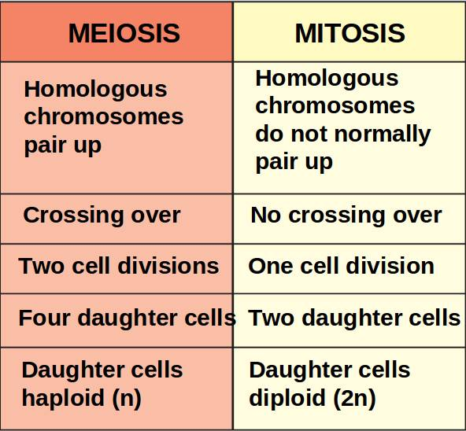
Study Guide
6) Describe three differences between meiosis and mitosis.

Slide 11
Study Guide
7) Describe three differences between asexual reproduction and sexual reproduction.
Asexual reproduction use for grow, make a new organism, and replace old or damaged parts. The offspring will have the same genes as the parent.
Sexual reproduction ; requires a male and female of the same species to produce offspring.
meiosis produce gametes (half of the chromosomes of normal body cell). Fertilization occur between gametes (One egg cell, one sperm). It increase diversity within species.

Slide 12
Study Guide
8) Describe the relationship between genetics and lifestyle choices in human growth and development.
Genetic influences some lifestyle choices and some lifestyle choices influence expression of genes.
Heart disease is a one problem that can develop as a result of poor diet and lack of exercise.

Slide 13
Study Guide
What is the purpose of a Pedigree chart? What do the symbols represent?
Pedigree chart trace genetic disorder.
A square represent male
A circle represent female
A circle that is filled in means female, affected.
A circle that is filled in means male, affected

Slide 14
Study Guide
What is evolution?
Biological evolution account for the diversity of species over time.
Natural Selection examples; White moths died and black moths continued to reproduce due to polluted air.
The predominant color of Rat snakes will depend on their environment .
Bacteria adapted to eat nylon
Genetic disorders are sometimes caused by environment and sometimes by gene mutations.

Slide 15
Study Guide
11) Of sixteen rabbits born, twelve have black fur and four have white fur. The trait for white fur is considered recessive .
Punnett square is always show the chances. (There is no definite, more likely or less likely result )
When will a recessive trait appear?
In the absence of dominant alleles.

Slide 16
Study Guide
12) How many chromosomes are contained in an average human body cell ?
46

Slide 17
Kahoot.
https://play.kahoot.it/#/?quizId=76aa1d4c-59de-46c1-b42a-4d425f9c8ecd

