Slide 1
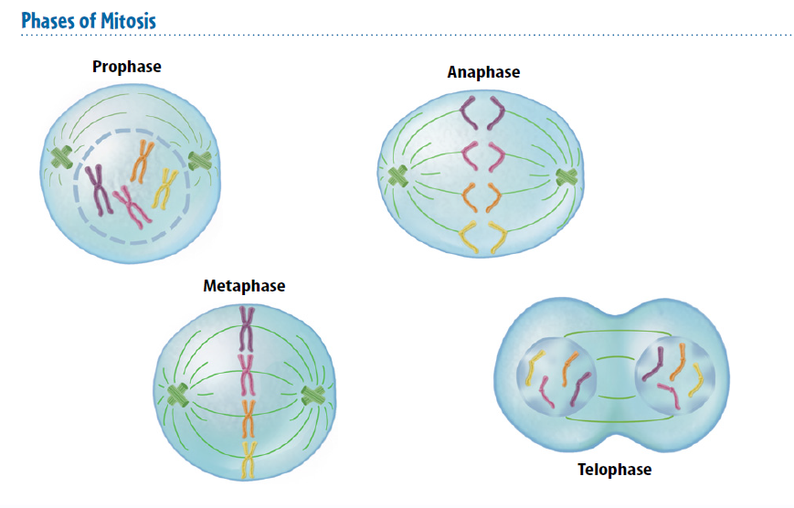
Warm Up 5 minutes 1/5/18 Write and Draw the shape

Slide 2
Today Agenda
1) Warm Up 5 minutes
2) Lesson Outline- 13 minutes
3) Content Practice- Guided Practice- 10 minutes
4) Video-Kahoot - Independent Practice- 15 minutes
5) Exit ticket –Socrative.

Slide 3
Lesson Outline for Teaching Lesson 1: The Cell Cycle and Cell Division
A. The Cell Cycle
1. Most cells in an organism go through a cycle of growth, development, and division called the cell cycle.
2. Because of the cell cycle, organisms grow and develop, replace old or damaged cells, and produce new cells.
B. Phases of the Cell Cycle
1. There are two main phases of the cell cycle—interphase and the mitotic phase.
2. Interphase is the period of growth and development for a cell.
3. During interphase, most cells go through three stages—rapid growth and replication of the organelles; replication of DNA, the genetic information in a cell; and preparation for cell division.
4. During the mitotic phase, a cell reproduces.

Slide 4
Lesson Outline for Teaching Lesson 1: The Cell Cycle and Cell Division
C. Length of a Cell Cycle
1. Interphase makes up most of the cell cycle.
2. During interphase, the DNA in the cell is called chromatin.
D. Phases of Interphase
1. Interphase begins with a period of rapid growth—the G1 stage.
2. During the S stage of interphase, the cell replicates its strands of chromatin.
3. Sister chromatids are the two identical strands of DNA that make up the duplicated chromosome.
4. The sister chromatids are held together by a structure called the centromere.
5. The final stage of interphase—the G2 stage—is a period of growth and final preparation for mitosis.

Slide 5
Lesson Outline for Teaching Lesson 1: The Cell Cycle and Cell Division
E. Organelle Replication
1. Before a cell divides, it makes copies of all its organelles.
2. In mitosis, the nucleus and its contents divide.
3. In cytokinesis, the cytoplasm and its contents divide.
4. Two new daughter cells result from mitosis and cytokinesis.
F. Phases of Mitosis
1. During prophase, duplicated DNA condenses into chromosomes.
2. During metaphase, the chromosomes line up in the middle of the cell.
3. During anaphase, sister chromatids in each duplicated chromosome separate and are pulled in opposite directions by the spindle fibers.
4. During telophase, chromosomes begin to uncoil, and two new identical nuclei form.

Slide 6
Lesson Outline for Teaching Lesson 1: The Cell Cycle and Cell Division
G. Dividing the Cell’s Components
1. After mitosis, cytokinesis usually divides a cell’s cytoplasm, forming a new cell membrane around each daughter cell.
2. In animal cells, a(n) furrow in the middle of the cells gets deeper until the cell membrane comes together to divide the cell.
3. In plant cells, a(n) cell plate grows outward toward a new cell wall until two new cells form.
H. Results of Cell Division
1. The cell cycle results in two new daughter cells that are genetically identical to each other and to the original cell, which no longer exists.
2. The cell cycle is important for reproduction in some organisms, growth in multicellular organisms, replacement of worn-out or damaged cells, and repair of damaged tissues.

Slide 7
Content Practice A (page 13)
1. cell cycle
2. sister chromatids
3. mitosis
4. cytokinesis
5. daughter cells
6. centromere
7. interphase
8. identical
9. unicellular
10. multicellular
11. no longer exists

Slide 8
Content Practice B (page 14)
1. interphase and the mitotic phase
2. interphase
3. mitotic phase
4. Possible answer: In mitosis, the nucleus and its contents divide. In cytokinesis, the cytoplasm and its contents divide.
5. A chromosome is made of two sister chromatids attached at the center by a centromere.
6. Two daughter cells are produced at the end of the cell cycle. They are identical to each other and to the parent cell. The parent cell no longer exists.
7. Possible answer: The cell cycle allows some unicellular organisms to reproduce by producing two identical organisms from one parent organism.
8. Possible answer: The cell cycle allows multicellular organisms to produce more cells for growth, to replace cells, and to repair damage.

Slide 9
Brain Pop
Mini quiz. (Kahoot)
You have to write your real name to be graded.
No name or nickname will get 0.

