Slide 1
10-12-17 Thursday Warm Up 5 minutes
1) Wind is caused by:
temperature and pressure differences
2) When a mass of air is cooling, what will happen when the air temperature reaches the dew point?
Water vapor in the air will begin to condense.
3) Imagine that it is summertime and the air around
you is warm and humid. What type of weather can
you expect as a cool, dry air mass rapidly approaches?
Answer; thunderstorms

Slide 2
Today Agenda
1) Warm Up 5 minutes
2) Study Guide (Remaining Questions)
2) Content Practice/ Key Concept Builder
3) Socrative- Space Race

Slide 3
Study Guide

Slide 4
Content Practice 5 minutes Each question-10 points
Content Practice A (page 69)
1. respiratory
2. nonpoint
3. smog
4. sulfur dioxide
5. marsh bacteria
6. thousand
7. smallest
8. inversion
9. Clean Air
10. maroon

Slide 5
Content Practice Part B 5 minutes Each question 20 points
1. A point source of air pollution is an identifiable source, such as a factory. A nonpoint source is spread out, such as all the cars in a city.
2. In the stratosphere, ozone blocks harmful ultraviolet rays from the Sun. At ground level, ozone can damage the tissues of humans, plants, and animals.
3. Sunlight interacting with nitrogen dioxide from gasoline exhaust causes a series of chemical reactions that produce ozone and other compounds.
4. These cities often experience temperature inversions. Cool air, with the pollution it contains, gets trapped in the valley beneath a layer of warm air.
5. good—green; moderate—yellow; unhealthy for some groups—orange; unhealthy—red; very unhealthy—purple; hazardous—maroon

Slide 6
Key Concept Builder 5 minutes Each question is 10 point
1. N 2. P 3. P 4. N 5. P 6. N 7. N 8. P
9. acid rain (or acid precipitation)
10. asthma, bronchitis, and emphysema (also accept lung cancer)

Slide 7
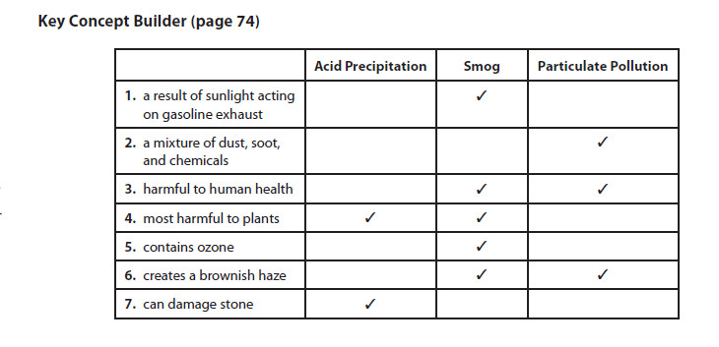
Key Concept Builder 5 minutes Each Question is 10 points
8. rain, snow, fog, and mist
9. sulfur dioxide and nitrogen oxides
10. children and elderly

Slide 8
Socrative-Rocket Launch
You are going to www.socrative.com
Your room name is your college name;
Bosphorus- Bosphorus
Texas A&M- TEXASAM
Umad- UMAD
Berkeley- BERKELEY1
Caltech-CALTECH1
Your ID number same with your plicker number.

