Slide 1
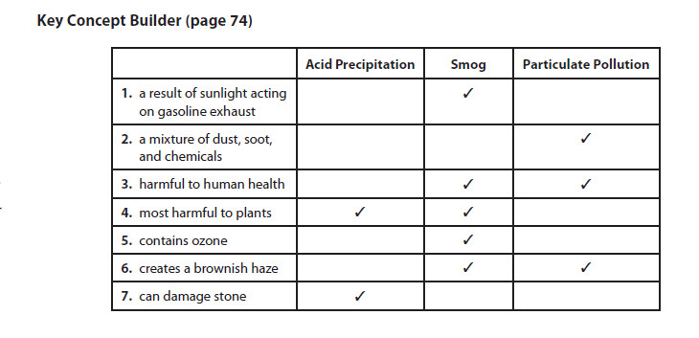
Key Concept Builder-Homework Check 5 minutes
1. N 2. P 3. P 4. N 5. P 6. N 7. N 8. P
9. acid rain (or acid precipitation)
10. asthma, bronchitis, and emphysema (also accept lung cancer)
8. rain, snow, fog, and mist
9. sulfur dioxide and nitrogen oxides
10. children and elderly

Slide 2
Warm Up 5 minutes 10/13/17
A fast approaching cold air mass is moving in to displace a warm moist air mass in the summertime. Which of these kinds of weather is most likely?
A. a drought
B. drizzling rain
C. snow
D. a thunderstorm
Answer; D

Slide 3
Today Agenda
1) Homework Check 5 minutes
2) Warm Up 5 minutes
3) Unit Test 33 minutes

Slide 4
Unit Test B
1) You are not allowed to talk during the test.
2) You are not allowed to leave the classroom (Bathroom break , water until you finish your test)
3) There will be no warning (Write up –Conceptsist Level 3 Academic Dishonesty- 0 on the test and IRR )

Slide 5
Socrative
You are going to www.socrative.com
Your room name is your college name;
Bosphorus- Bosphorus
Texas A&M- TEXASAM
Umad- UMAD
Berkeley- BERKELEY1
Caltech-CALTECH1
Your ID number same with your plicker number.

