Slide 1
Warm Up
Contrast a plant cell with an animal cell . How can you tell them apart?

Slide 2
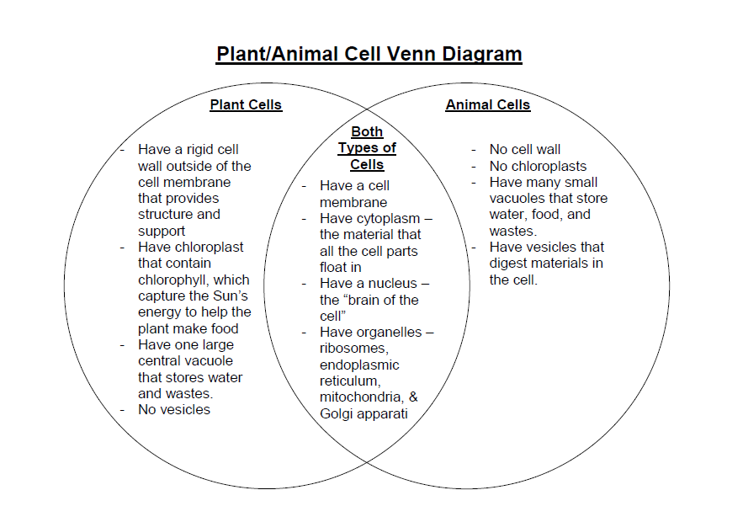
Answer

Slide 3
Agenda
1) Warm up 5 minutes
2) Video Plant cell and Animal Cell
3) Classwork (Cell Coloring)
4) Review.
5) Study Guide Distribution

Slide 4
Video
Animal Cell

Slide 5
Video
Plant Cell

Slide 6
Classwork (Paint Cell )

