Slide 1
Warm up 10/24/16 Monday 5 minutes
1)What invention helped scientists to discover cells?
The microscope-This instrument is used to magnify micro-organisms and cells

Slide 2
Today Agenda
1) Warm up 5 minutes
2) Project for extra credit (City cell project) 10 minutes.
3) Study Guide Review and answer the question. 25 minutes.
4) Cell Vocabulary Game

Slide 3
Study Guide review answer
2) List three scientists who contributed to the development of cell theory.

Slide 4
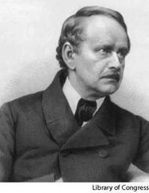
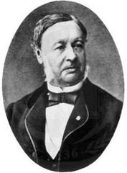
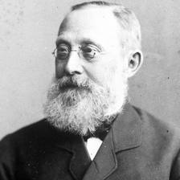
Answer
1)Matthias Schleiden
1838 German botanist who determined plants are composed of cells.
2)Theodor Schwann
German physiologist and histologist who in 1838 and 1839 identified the cell as the basic structure of plant and animal tissue (1810-1882)
Rudolph Virchow
1858 - A doctor who stated that all living cells come from other living cells (part 3 of the cell theory)

Slide 5
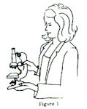
Study Guide review answer
3) When looking under the microscope, you should start with the ______ power objective
Lower Lens
4) How should you carry a microscope?
When moving your microscope, always carry it with both hands (Figure 1). Grasp the arm with one hand and place the other hand under the base for support.

Slide 6
5)What is cell theory? (Three parts)
Cell Theory #1
Cells are the basic structure and function of a living thing
Cell Theory #2
All organisms (living things) are made out of cells
Cell Theory #3
only existing cells can make new cells

Slide 7
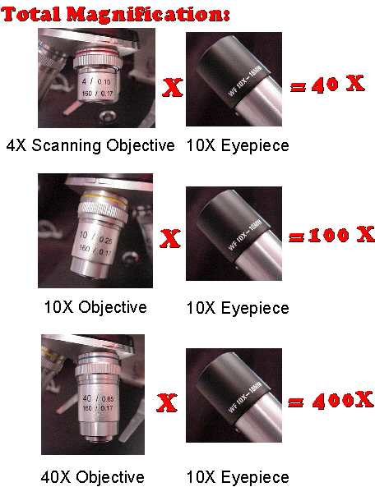
6)How do you determine the total magnification on a microscope?
To figure the total magnification of an image that you are viewing through the microscope is really quite simple. To get the total magnification take the power of the objective (4X, 10X, 40x) and multiply by the power of the eyepiece, usually 10X

Slide 8
7)What are organelles?
Small structures inside a cell that carry out specific functions.

Slide 9
8)Which cell organelle is responsible for providing energy for the cell.
Mitochondria

Slide 10
9)List two differences between plant and animal cells.
Cell wall and Chloroplast (plant cell)

Slide 11
10)Which organelle controls all cell activities and contains the genetic material?
Nucleus

Slide 12
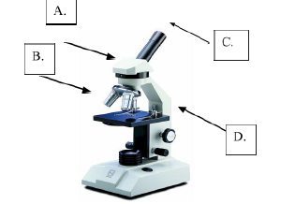
List the parts of microscope
Nosepiece
Objective Lenses
Eye pieces
Stage

