Slide 1
Warm Up 5 minutes 10-3-17 Tuesday
Explain the differences between/among each set of terms on the lines provided. You must include the terms below in your answer.
high-pressure system, low-pressure system
tornado, hurricane
air mass, front

Slide 2
Answer of the bell ringer
High-pressure systems bring clear skies, and low-pressure systems bring precipitation.
A tornado is contacts the ground, hurricane forms over the ocean
An air mass is a large body of air that has specific characteristics, and a front is the boundary between two different air masses.

Slide 3
Today Agenda
1) Warm Up 5 minutes
2) Video (Hurricane 101 and Hurricane vs Tornado)- 7 minutes
3) Key Concept Builder- 10 minutes
4) Concept Practice 10 minutes
5) Kahoot/ Quizlet Live 10 minutes
6) Homework 1 minute

Slide 4
Video
1) Hurricane 101
2) Hurricane vs Tornado

Slide 5
Chromebook
You are going to www.ailbay.weebly.com
(You can google ailbay)
Click 7th Grade Science and Click First quarter homework and project)
You are going scroll down and click the presentation for the answer.
The presentation date is 10-3-17 Tuesday

Slide 6
Key Concept Builder- Page 36
1. toward the center
2. rises
3. outward
4. falls
5. A low-pressure system is a large body of circulating air that has low pressure at its center and higher pressure on the outside.
6. A high-pressure system is a large body of circulating air that has high pressure at its center and lower pressure on the outside

Slide 7
Key Concept Builder- Page 37
1. Siberia and the arctic
2. bitterly cold and dry
3. -40°C
4. in the interior of Canada and Alaska
5. cold, dry air
6. cold temperatures in winter and cool weather in summer
7. over the northern Atlantic and Pacific oceans
8. cold and humid

Slide 8
Key Concept Builder- Page 37
9. cloudy and rainy
10. over dry, desert land
11. hot and dry
12. during the summer
13. clear skies and high temperatures
14. near the equator
15. hot and humid
16. heavy snowfall

Slide 9
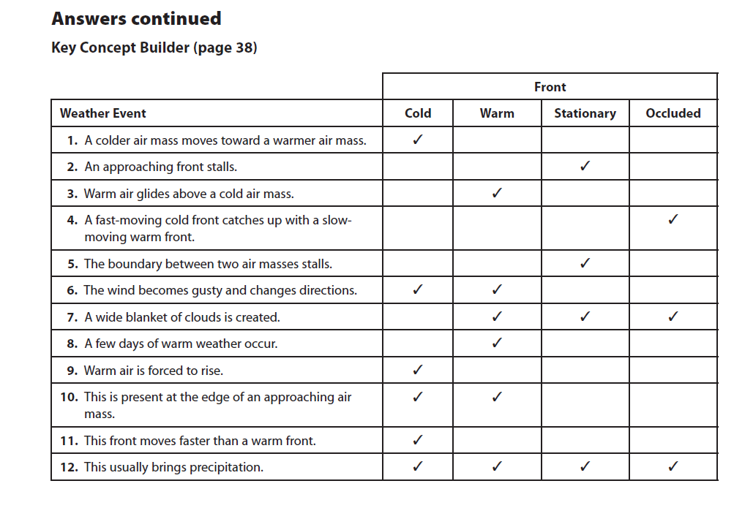
Key Concept Builder- Page 38

Slide 10
Key Concept Builder- Page 39
1. Clouds form, and updrafts occur.
2. Heavy winds, rain, and lightning dominate the area.
3. Updrafts cut off, winds die down, lightning ceases.
4. Stay inside; stay away from water, high places, and electrical devices.
5. Thunderstorm updrafts begin to rotate.

Slide 11
Key Concept Builder- Page 39
6. Swirling winds spiral downward.
7. Dirt and debris are lifted upward; large objects are thrown.
8. Go to a basement, if possible.
9. An area of low pressure is created.
10. counter-clockwise

Slide 12
Key Concept Builder- Page 39
11. tropical storm
12. when wind exceeds 119 km/h
13. Leave the area before the hurricane arrives.
14. Ice coats the ground, trees, and buildings. 15. Skin cools rapidly, frostbite is possible, and hypothermia can set in.

Slide 13
Content Practice 10 minutes
This is your independent practice please give to me before you leave the classroom.

Slide 14
Kahoot/ quizlet live
https://play.kahoot.it/#/?quizId=a843543d-f13a-4800-b794-6b2a846d271f
https://quizlet.com/192151096/weather-patterns-flash-cards/
https://quizlet.com/163566308/weather-pattern-flash-cards/

