Slide 1
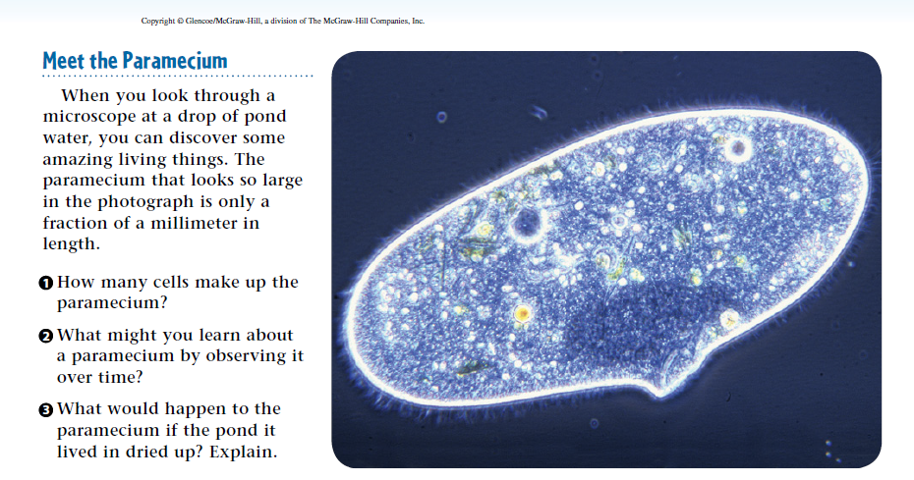
Warm Up 5 minutes 10/31/17 Tuesday

Slide 2
Warm Up Answer
1)One
2) Possible answers include learning how the
paramecium moves, takes in food, or responds to its environment.
3 The paramecium would dry up and die. Like all
cells, a paramecium is made mostly of water and needs water to survive.

Slide 3
Today Agenda
1) Warm Up 5 minutes
(Important Dates of 2nd Quarter)
2) Introduction Chapter 10 minutes
3) Lesson 1 Protists Introduction-5 minutes
4) Lesson 1 Protists Vocabulary- 10 minutes
5) Video/interactive activity 13 minutes
6) Homework-Content Vocabulary

Slide 4
Protists and Fungi- Don’t Write it down
Plant or Animal?

Slide 5
Protists and Fungi- Write it Down-Competition
What are protists and fungi, and how do they affect an environment?
Protists and fungi are diverse groups of organisms. They are classified as neither plant nor animal and serve many functions in the ecosystem.

Slide 6
Protists and Fungi- Write it Down-Competition
Lesson 1: What are protists?
Scientists divide protists into three groups based on the type of organisms they most resemble. There are plantlike, animal-like, and funguslike protists.
Protists are beneficial to humans in many ways. They are used to create many of the useful products you depend on. They also help decompose dead organisms and return nutrients to the environment.

Slide 7
Protists and Fungi- Write it Down-Competition
Lesson 2: What are fungi?
Scientists divide fungi into four groups, based on the type of structures they use for sexual reproduction. The four groups are club fungi, sac fungi, zygote fungi, and imperfect fungi.
Fungi provide many foods and medicines that people use. In addition, fungi help break down dead organisms and recycle the nutrients into the environment.

Slide 8
1
What are protists?
Do you agree or disagree?
Protists are grouped together because they all look similar.
Some protists cause harm to other organisms.
Many protists make their own food.

Slide 9
1
What are protists? (Don’t Write it down)-Check your answer
1)Disagree. Protists are grouped according to organisms they most closely resemble.
2) Agree. Some protists can cause disease by acting as parasites.
3) Agree. Algae are plantlike protists that produce food through photosynthesis.

Slide 10
1
What are protists?-Next Slide you will write the definition -Competition
Algae
Amoeba
Asexual reproduction
Cilia
diatom
Paramecium
Process
Protist
Protozoan
Pseudopod

Slide 11
Lesson 1 Vocabulary
algae plantlike protists that produce food through photosynthesis
amoeba common sarcodine with unusual adaptation for movement and obtaining nutrients
asexual reproduction one parent reproduces without a sperm and an egg joining
cilia short, hairlike organelles that grow on the surface of some protists
diatom plantlike protist with a hard outer wall
paramecium protist with cilia and two nuclei
process event marked by gradual changes that lead toward a particular result
protist member of a group of eukaryotic organisms
protozoan protist resembling a tiny animal
pseudopod temporary “foot” made when an amoeba pushes part of its body outward

Slide 12
Video
1) Smart Board

