Slide 1
Content Practice-Check Your Homework ANSWER
Content Practice A (page 30)
1–5. (in any order) freezing rain, tornadoes,
hurricanes, blizzards, thunderstorms
6–7. (in either order) temperature, humidity
8–11. (in any order) cold front, warm front,
stationary front, occluded front
Content Practice B (page 31)
1. hurricane
2. air mass
3. maritime
4. front
5. low-pressure system
6. denser
7. warm
8. occluded
9. thunderstorm
10. thunder
11. continental
12. tornadoes
13. tropical
14. hurricane

Slide 2
Warm up 5 minutes 10-4-17 Wednesday
Cloudy and rainy weather is associated with a(n)_________ air mass.
Answer; maritime polar
2. A(n)_____ front brings several days of steady rain or snow into an area.
Answer; stationary
3. A thunderstorm would likely cause severe flooding during its_________stage.
Answer; mature

Slide 3
Today Agenda
1) Homework Check/Bell Work 10 minutes
2) Open Notebook Quiz- Plicker 10 minutes
3) Lesson 3 Introduction 15 minutes-Science Journal.
4) Content Vocabulary 5 minutes
5) Homework

Slide 4
Plicker-Open Notebook quiz
There are 10 question each question 10 point.
You are going to use plicker to answer question. You need to put the letter upside for the answer you want to pick.
If you talked or say the answer your answer will not scan from the teacher and you got automatically get 0.
Review video

Slide 5
3
Weather Forecasts

Slide 6
3
Weather Forecasts
Weather variables are measured every day at locations around the world.
Agree. A package of instruments on a weather balloon, called a radiosonde, sends reports twice daily from hundreds of locations around the world
Modern weather forecasts are done using computers.
Agree. Computer models solve mathematical formulas to predict temperature, wind, rain, snow, and types of clouds.

Slide 7
3
Weather Forecasts
What instruments are used to measure weather variables?
Thermometers, barometers, anemometers, radiosondes, satellites, and Doppler radar are used to measure variables
How are computer models used to predict the weather?
Computer models use complex mathematical formulas to predict temperature, wind, cloud formation, and precipitation.

Slide 8
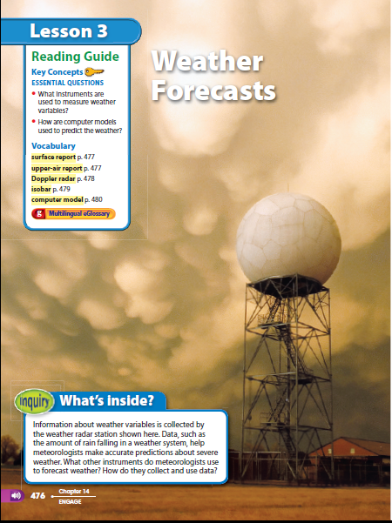
INQUIRY
What’s inside?
RADAR STATION
Look at the photo at the beginning of the lesson. Information about weather variables is collected by the weather radar station shown here. Data, such as the amount of rain falling in a weather system, help meteorologists make accurate predictions about severe weather.
What other instruments do meteorologists use to forecast weather?
How do they collect and use data?

Slide 9
3
Weather Forecasts
surface report
upper-air report
Doppler radar
isobar
computer model

Slide 10
Vocabulary Lesson 3
Surface report describes a set of weather measurements made on Earth’s surface
upper-air report describes wind, temperature, and humidity conditions above Earth’s surface
Doppler radar specialized radar that can detect precipitation and movement of small particles and can approximate wind speed
isobar line on a map used to connect all places where air pressure has the same value
computer model detailed program that solves a set of complex mathematical formulas

Slide 11
Content Vocabulary-Classwork
Student who didn’t finish will do as a homework.

Slide 12
Homework
4 questions answer-Lesson 2 Weather Pattern.

