Slide 1
HOMEWORK CHECK
School to Home
1) Low-pressure systems create clouds and sometimes precipitation. High-pressure systems create clear skies and fair weather.
2. There are continental, maritime, tropical, polar, and arctic air masses,
3)The four types of fronts are cold fronts, warm fronts, stationary fronts, and occluded fronts
4) Hurricanes typically form in late summer over warm, tropical ocean water.
Content Vocabulary order;
1. Doppler radar2. isobars 3. computer models 4. surface report
5. upper-air report

Slide 2
10-5-17 Thursday Warm Up
1) What is definition of isobar.
isobar line on a map used to connect all places where air pressure has the same value

Slide 3
Today Agenda
1) Homework Check/ Bell Ringer 10 minutes
2) Introduction Lesson 3 7 minutes
3) Lesson Outline/Read to Learn 10 minutes
4) Content Practice 10 minutes
5) Homework
P;S (Open your textbook page 257/260)

Slide 4
3
Weather Forecasts

Slide 5
3
Weather Forecasts
Weather variables are measured every day at locations around the world.
Agree. A package of instruments on a weather balloon, called a radiosonde, sends reports twice daily from hundreds of locations around the world
Modern weather forecasts are done using computers.
Agree. Computer models solve mathematical formulas to predict temperature, wind, rain, snow, and types of clouds.

Slide 6
3
Weather Forecasts
What instruments are used to measure weather variables?
Thermometers, barometers, anemometers, radiosondes, satellites, and Doppler radar are used to measure variables
How are computer models used to predict the weather?
Computer models use complex mathematical formulas to predict temperature, wind, cloud formation, and precipitation.

Slide 7
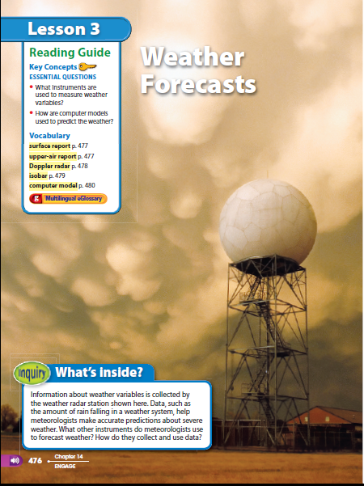
INQUIRY
What’s inside?
RADAR STATION
Look at the photo at the beginning of the lesson. Information about weather variables is collected by the weather radar station shown here. Data, such as the amount of rain falling in a weather system, help meteorologists make accurate predictions about severe weather.
What other instruments do meteorologists use to forecast weather?
How do they collect and use data?

Slide 8
3
Weather Forecasts
surface report
upper-air report
Doppler radar
isobar
computer model

Slide 9
Vocabulary Lesson 3
Surface report describes a set of weather measurements made on Earth’s surface
upper-air report describes wind, temperature, and humidity conditions above Earth’s surface
Doppler radar specialized radar that can detect precipitation and movement of small particles and can approximate wind speed
isobar line on a map used to connect all places where air pressure has the same value
computer model detailed program that solves a set of complex mathematical formulas

Slide 10
Lesson Outline
A. Measuring the Weather
1. Meteorologists measure weather variables before making a forecast.
2. A(n) surface report describes a set of weather measurements made on Earth’s surface.
3. Measurements include temperature, air pressure, humidity, precipitation, and wind speed and direction.
4. A(n) upper-air report describes wind, temperature, and humidity conditions above Earth’s surface.
5. A(n) radiosonde is a package of weather instruments that are carried into the atmosphere by a weather balloon.

Slide 11
Lesson Outline
6. Satellites provide weather information by measuring the radiation given off by Earth and by taking photographs.
7. Infrared satellite images provide information about cloud temperature and height.
8. Doppler radar is a special form of radar that can be used to detect precipitation and approximate wind speed

Slide 12
Lesson Outline
B. Weather Maps
1. The station model displays many weather measurements for a specific location. It appears on weather maps.
2. Weather maps have isobars, which are symbols made up of lines that connect places that have equal air pressure. These lines give information about wind speed.
3. Isotherms are lines that connect places that have the same temperature.
4. Fronts are represented as lines with symbols on them.

Slide 13
Lesson Outline
C. Predicting the Weather
1. Modern weather forecasts are made with the help of computers.
2. Computer models are detailed computer programs that solve a set of complex mathematical formulas. The formulas predict temperature, winds, precipitation, and types of clouds.

Slide 14
Video

Slide 15
Content Practice 10 minutes
Content Practice A (page 51)
1–2. (in either order) surface reports, upper-air
reports
3. satellite images
4. radar images
5. Doppler
6–7. (in either order) visible, infrared
8. a prediction about what the weather will be
like in a certain place at a certain time
9. Possible answer: They show what weather will
be like in different places at different times.
10. Possible answer: Computers quickly analyze a
lot of information to make a prediction.

Slide 16
Content Practice 10 minutes
Content Practice B (page 52)
1. 70°F
2. Possible answer: It is warm and humid.
3. It has risen two units.
4. Possible answer: High pressure is moving in, and the skies might clear.
5. Possible answer: There might be a warm front moving through the area, so it should remain warm.
6. Possible answer: pressure bars, areas of low and high pressure, more temperatures, warm front symbols
7. Possible answer: The computer model would quickly analyze temperatures, wind direction, areas of high- and low-pressure, humidity, precipitation amounts, and cloud coverage to make short- and long-term weather predictions.

Slide 17
Homework
School to Home

