Slide 1
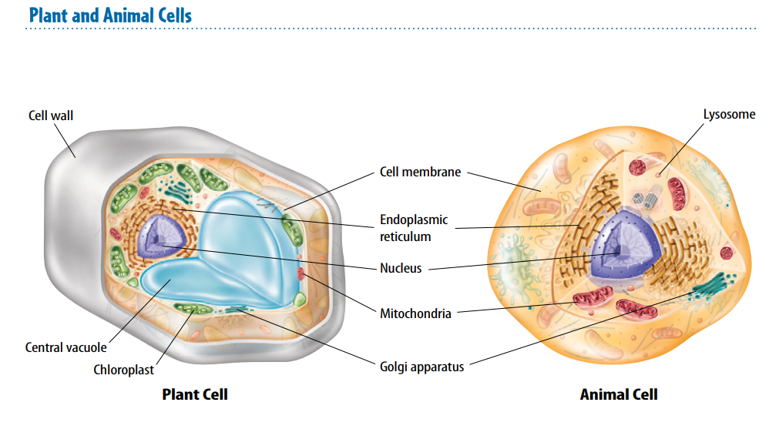
Warm Up 4 min 10/18/18 Thursday Write the similarity and differences between animal and plant cell.

Slide 2
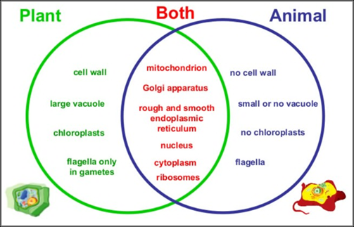
Warm Up Answer

Slide 3
Today Agenda
1) Warm Up 4 min
2) Content Practice
3) Video (Bill Nye Science Guy)
4) Plicker
5) Extra Credit Project (Cell Project)
Reminder
Homework Packet 10/19/18 •STEM FAIR STEP 2 (Background Research) due is Friday •Open Notebook Quiz- Friday.

Slide 4
Content Practice A (page 33)
1. cytoplasm
2. Prokaryotic cells
3. Mitochondria
4. mitochondria
5. prokaryotic cells
6. Cytoplasm
7. Eukaryotic cells
8. prokaryotic cells

Slide 5
Content Practice B (page 34)
Cell
Macromolecules
Organelles
Cell membrane
cell wall
Structure
Water
Proteins

Slide 6
Bill Nye Science Guy- Cell
https://vimeo.com/116866613

Slide 7
Cell Project Extra Credit
https://sites.google.com/a/micharter.org/science/science-projects/cell-3-d-model-information

Slide 8
Cell (Plicker)

