Slide 1
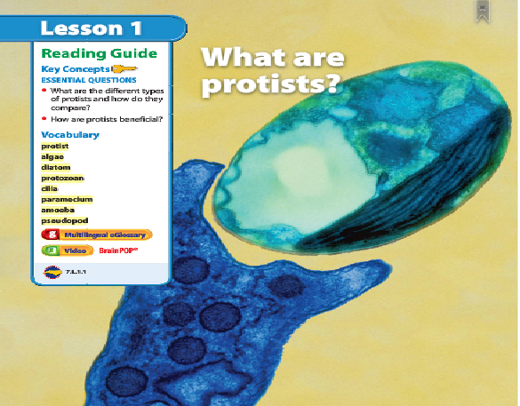
1
Warm up 5 minutes 11/1/2017 Wednesday
Grabbing a Snack?
Look at the photo at the beginning of the lesson. The protist group includes diverse organisms.
1)What is the larger organism doing in the photo?
2)How is this organism similar to an animal?

Slide 2
Warm Up Answer
Consuming the food
It is similar to animal because they are consumer.

Slide 3
Today Agenda
1) Warm Up 5 minutes
2) Read to Learn Pages Textbook 337-345
3) Lesson Outline
4) Video
5) Homework-School to Home

Slide 4
Read to Learn Textbook 337-345
1) Pay attention while we are reading we are also fill in the blanks for the lesson outline.

Slide 5
Video and Smart Board Activity
1) Video - Crawling Amoeba
2) Amoeba eats two paramecium
3) Euglena - Flagellum movement in phase contrast
4) Volvox Dances
5) Interactive

Slide 6
Homework
School to Home

