Slide 1
Warm Up 11-14-16 5 minutes
1) Where do cells come from?

Slide 2
Answer
No matter what the cell, all cells come from preexisting cells through the process of cell division.

Slide 3
Today Agenda
1) Warm Up (5 minutes)
2) Introduction of new unit (UNIT D Cellular Reproduction) 5 minutes
3) Power Point (15 minutes- Cell Division)
4) Difference between asexual and sexual reproduction. (15 minutes)

Slide 4
Cell Division
Where do cells come from?
The cell may be the simplest bacterium or a complex muscle, bone, or blood cell. The cell may comprise the whole organism, or be just one cell of trillions.

Slide 5
Cell Division
You consist of a great many cells, but like all other organisms, you started life as a single cell.
How did you develop from a single cell into an organism with trillions of cells?

Slide 6
Cell Division
The answer is cell division.
After cells grow to their maximum size, they divide into two new cells. These new cells are small at first, but they grow quickly and eventually divide and produce more new cells. This process keeps repeating in a continuous cycle.

Slide 7
Cell division is the process in which one cell, called the parent cell, divides to form two new cells, referred to as daughter cells.
How this happens depends on whether the cell is prokaryotic or eukaryotic.

Slide 8
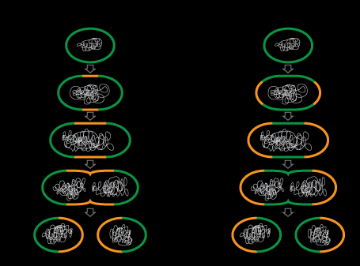
Cell Division in Prokaryotes
Most prokaryotic cells divide by the process of binary fission. A bacterial cell dividing this way is depicted in Figure below.

Slide 9
Cell Division in Eukaryotes
Cell division is more complex in eukaryotes than prokaryotes. Prior to dividing, all the DNA in a eukaryotic cell’s multiple chromosomes is replicated. Its organelles are also duplicated.

Slide 10
Do animals always have two parents?

Slide 11
Cellular Reproduction
No, not all animals have two parents. When necessary, some animals can be produced from just one parent. Some reptiles, such as this Komodo dragon, have only one parent. The process of creating offspring from just one individual is called asexual reproduction.

Slide 12
Reproduction
Reproduction is the ability to make the next generation, and it is one of the basic characteristics of life.
Two methods of reproduction are: Asexual and sexual.

Slide 13
Asexual reproduction, the process of forming a new individual from a single parent.
Sexual reproduction, the process of forming a new individual from two parents.

Slide 14
Asexual Reproduction
Having just one parent is possible in other eukaryotic organisms, including some insects, fish, and reptiles. These organisms can reproduce asexually, meaning the offspring ("children") have a single parent and share the exact same genetic material as the parent.

Slide 15
The advantage of asexual reproduction
It can be very quick and does not require the meeting of a male and female organism

Slide 16
The disadvantage of asexual reproduction
Organisms do not receive a mix of traits from both parents.

Slide 17
Types of organisms that reproduce asexually include:
Prokaryotic organisms, like bacteria.
Flatworms, an invertebrate animal species.
Different types of insects, fish, and lizards.

Slide 18
Types of Asexual
1) Binary Fission; Reproduction through growth and division of the cell, as in bacteria.
2)Fragmentation: Reproductive process in which a new organism forms from a fragment of a parent organism. (Flatworms)
3)Parthenogenesis: Growth of an unfertilized egg cell into a new organism.

Slide 19
Asexual Reproduction

Slide 20
Video (Types of Asexual Reproduction)

