Slide 1
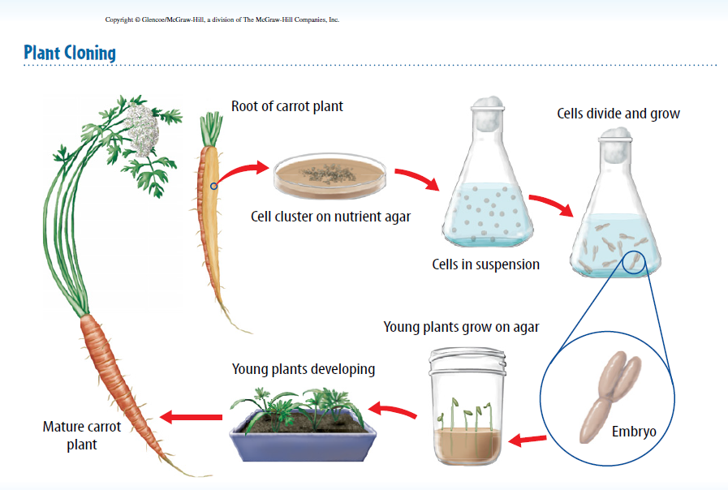
Warm Up 5 minutes 11-21-17 Tuesday Write the steps of plant cloning

Slide 2
Today Agenda
1) Warm Up 5 minutes
2) Project Based Learning- Quizlet
3) Quizlet Live
4) Kahoot Game

Slide 3
PBL (Flash Card)
1) You are going to www.quizlet.com
2) Continue create your flash card for cell reproduction chapter.
3) Remember today is the last day and you will get your grade for the project.
4) Last 10 minutes we will play the game .
5) If you didn’t create an account yet please go to my website for clear direction.
6) When you finish click create and click plus sign and share the study set with your classroom.

Slide 4
Procedures
You are going to create an account on quizlet and join my classroom. Please click these link (also available on my website)
https://quizlet.com/join/uY5Ay5awX Berkeley
https://quizlet.com/join/vJVnm9nHM Bosphorus
https://quizlet.com/join/44V8Muzj7 Caltech
https://quizlet.com/join/Tesps3CVB Texas
https://quizlet.com/join/7DYzyKqEP Umad
Then click sign up free request access. (Username-needs to include firstname)
Than click join class.
Started create study set (20 words- 10 Sexual Reproductiuon , 10 Asexual Reproduction)

Slide 5
Quizlet.live / Kahoot

