Slide 1
Warm Up 11/28/17 5 minutes
Classify features of asexual reproduction as advantages or disadvantages. Write “A” for advantage and “D” for disadvantage in the center column of the table below. Explain your reasoning in the right-hand column.
Does not require a mate
Can occur rapidly
Produces little genetic variation I found this on page . Use

Slide 2
Answer of the Bell Ringer
Does not require a mate | A | Because organisms do not need to search for mates in order to reproduce, they use less time and energy.
Can occur rapidly | A | Organisms can reproduce rapidly, producing a large number of offspring.
Produces little genetic variation | D | Less genetic variation within a species makes it more vulnerable to environmental changes.

Slide 3
Today Agenda
1) Warm Up 5 minutes
2) Content Vocabulary- 5 minutes
3) Brain Pop- Chromebook 25 minutes
4) Kahoot 7 minutes

Slide 4
Content Vocabulary- 5 minutes
There are 8 word of each vocabulary.
Student who show the work done, you can get the Chromebook to start your brain pop assignment
Answer .
1) Fission
2) Budding
3) Culture
4) Potential
5) Regeneration
6) Asexual reproduction
7) Vegetative reproduction
8) Cloning

Slide 5
Brain Pop
1) If you have an account log in and start your asexual reproduction assignment.
2) You can ask me your username and password .
3) If you didn’t create and account- enter the code and sign up for the new username
Code; caltech7/umad77/texas7/berkeley7/bosphorus7
Then please go ahead click sign up(You need create your account first than log in with your new account)

Slide 6
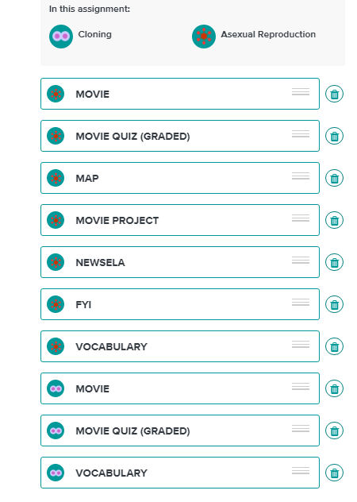
Brain Pop Assignment-Due Date 12/1/17- 25 minutes
There are 10 items on the list and each one of them is 10 points.
I will put grade up today but you can finish till Friday.(Grade can be updated)

Slide 7
Kahoot- 7 minutes
https://play.kahoot.it/#/?quizId=cb00a690-1def-46c9-bbd4-a41cd721dabf

