Slide 1
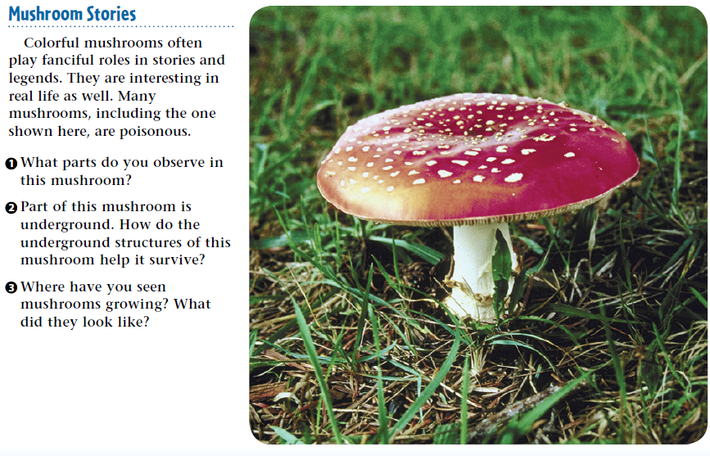
Warm Up 5 minutes 11-6-17 Monday
1)

Slide 2
Bell Work Answer
1) The parts include a narrow stalk and a wide, umbrella-shaped cap.
2 The mushroom must have underground parts to anchor it and to take in water and nutrients.
3 Mushrooms can have a variety of shapes, colors, and appearances. They typically are found on lawns, forest floors, and tree bark. Most mushrooms have a stalk and cap.

Slide 3
Today Agenda
1) Warm Up 5 minutes
2) Lesson 2 Introduction 10 minutes
3) Vocabulary 5 minutes
4) Classwork – Content Vocabulary 10 minutes
5) Video/ Video quiz 13 minutes
Reminder; STEM FAIR 4 Experimental Design due is today. (you can still bring there will be deduction -10 for every week)

Slide 4
Lesson Introduction-15 minutes
1) Do you agree or disagree
2) Key Concept Questions
3) Vocabulary

Slide 5
2
What are fungi?
Do you agree or disagree?
Mushrooms and yeasts are two types of fungi.
Fungi are always helpful to plants.
Some fungi can be made into foods or medicines.
Answers; 1) Agree 2) Disagree 3) Agree
Disagree-Some fungi, including sac fungi, cause diseases in plants.

Slide 6
2
What are fungi?
What are the different types of fungi and how do they compare?
Why are fungi important?
What are lichens?
1) four groups- club fungi, sac fungi, zygote fungi, and imperfect fungi.-Based on sexual reproduction
2) provide many foods and medicines , break down dead organisms
3) a structure formed when fungi and certain other photosynthetic organisms

Slide 7
2
What are fungi?
hyphae
mycelium
basidium
ascus
zygosporangia
mycorrhizae
lichen

Slide 8
Vocabulary
ascus reproductive structure where spores develop on sac fungi
basidium fungal reproductive structure that produces sexual spores
hyphae fungal structures that absorb minerals and water
lichen structure formed when fungi and certain photosynthetic organisms grow together
mushroom basidiocarp of a club fungi
mycelium network of hyphae
mycorrhizae structure formed by plant roots and hyphae woven together
zygosporangia tiny stalks that form when the fungus undergoes sexual reproduction

Slide 9
Classwork-Content Vocabulary
10 minutes max

Slide 10
Video/Video quiz
Video
Plicker

