Slide 1
Homework Check-5 minutes
1. a. Club fungi are fungi with club-shaped reproductive structures. Mushrooms are club fungi;
b.Sac fungi have reproductive structures called asci; yeast is a type of sac fungus;
c. Zygote fungi cause bread mold;
d. Imperfect fungi reproduce asexually. Ex; athlete’s foot.

Slide 2
Homework Check-5 minutes
2. a. Fungi break down dead plants and animals and return nutrients to the soil.
b. Mycorrhizae are formed when plant roots and fungi grow together
c. Fungi cause human diseases and disorders such as allergies, athlete’s foot, thrush;
d. Fungi are used to produce antibiotics such as penicillin

Slide 3
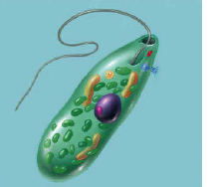
Warm Up 5 minutes 11/8/17 Wednesday
The organism shown below is…
Answer; a Euglena
2)_____ long, whiplike structure that helps organisms move through moist or wet surroundings.
Answer; flagellum

Slide 4
Today Agenda
1) Homework Check 5 minutes
2) Bell Work 5 minutes
3) Study Guide Review- 12 minutes
4) Station Activity 21 minutes

Slide 5
Study Guide

Slide 6
Station Activity-21 minutes
Each Station is three minutes.
Put your group name and member name.
It is going to be graded. (Classwork/participation)

