Slide 1
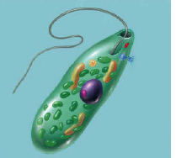
Warm Up 5 minutes 11/9/17 Thursday
The organism shown below is…
Answer; a Euglena
2)_____ long, whiplike structure that helps organisms move through moist or wet surroundings.
Answer; flagellum

Slide 2
Today Agenda
1) Warm Up 5 minutes
2) Unit Test 30 minutes
3) Kahoot/ Quizlet Live

Slide 3
Test Rules
1) You are not allowed to go bathroom or leave the classroom until you finish your test.
2) You cannot talk until everyone finish their test.
3) If you don’t follow the rules you will get a 0 and you will write up level 3 conceptsis. (Academic dishonesty)

Slide 4
Test Procedures
1) Go to www.socrative.com
2) Click student login
3) Room name; BOSPHORUS/TEXASAM/UMAD/BERKELEY1/CALTECH1
4) You are going to use your plicker number as an student ID.
5) After you finish you can go flocabulary or Brain Pop for extra credit work.(5 points addition to test score- (You are not allowed to take the test again-Same day)

Slide 5
Kahoot/ Quizlet
https://quizlet.com/122533948/protist-and-fungi-flash-cards/
https://play.kahoot.it/#/?quizId=fc16d32e-f230-4154-bf3a-49de27c94eb2

