Slide 1
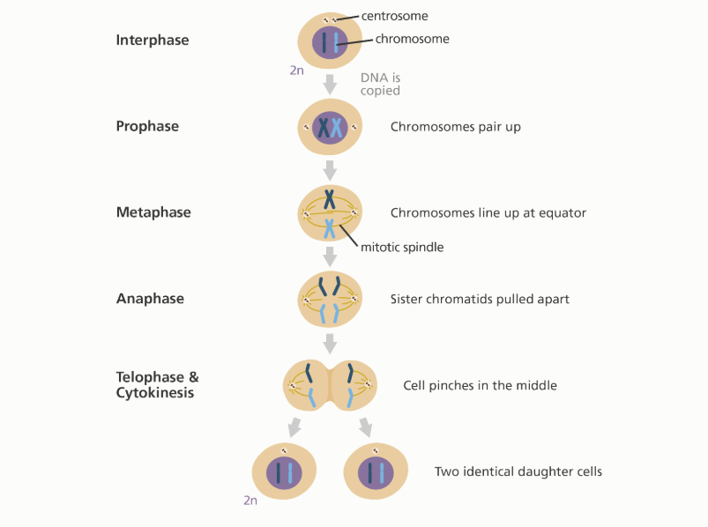
Warm up 11/1/18 Thursday 4 min
Explain the process of mitosis.
Answer;

Slide 2
Today Agenda
1) Warm Up 4 min
2) Content Practice Cell Cycle and Cell Division 10 min
3) Video 5 min
4) Plicker 25 min

Slide 3
Content Practice A (page 13)
1. cell cycle
2. sister chromatids
3. mitosis
4. cytokinesis
5. daughter cells
6. centromere
7. interphase
8. identical
9. unicellular
10. multicellular
11. no longer exists

Slide 4
Content Practice B (page 14)
1. interphase and the mitotic phase
2. interphase
3. mitotic phase
4. In mitosis, the nucleus and its contents divide. In cytokinesis, the cytoplasm and its contents divide.
5. A chromosome is made of two sister chromatids attached at the center by a centromere.
6. Two daughter cells are produced at the end of the cell cycle. They are identical to each other and to the parent cell. The parent cell no longer exists.
7. The cell cycle allows some unicellular organisms to reproduce by producing two identical organisms from one parent organism.
8. The cell cycle allows multicellular organisms to produce more cells for growth, to replace cells, and to repair damage

Slide 5
Video
https://www.youtube.com/watch?v=pOsAbTi9tHw&t=66s
(Mitosis Rap)

Slide 6
Plicker

