Slide 1
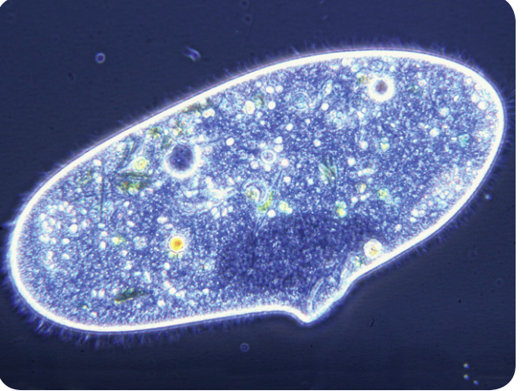
Warm Up 4 min 11/28/18 Wednesday
1) What would happen to the paramecium if the pond it lived in dried up? Explain
Answer; The paramecium would dry up and die. Like all cells, a paramecium is made mostly of water and needs water to survive.

Slide 2
Today Agenda
1) Warm Up 4 min
2) Quizlet.com (Vocabulary Practice ) Learn 25 min
3) Quizzez (Classwork Assignment) 15 min
Students who needs to take their chapter test- Go to Socrative
Gursey (Malachi and Ashlee )- Gurseytmsa(Room Name)
Bluford (Derrick) (Blufordtmsa)
Darwin ( Madison G, Monseratte, Isiah L) Darwintmsa
Carver ( Isatu, Emma, Thomas, Artaivian) Carvertmsa
McNair ( Mario, A'Azhanae , Ashley, Kaleb, Anaiya)-Mcnairtmsa

Slide 3
Quizlet.com (Vocabulary Practice)
1) Go to www.quizlet.com
2) Search Mr. Ilbay
3) Click the one Chapter 10 Protist and Fungi
4) You are going to do Learn on the Quizlet , You can practice flashcard before this activity.
5) You need to show me your progress on the system 100% progress or 16 mastered vocabulary.

Slide 4
Quizizz (Dependent Classwork)
There will be 15 multiple choice questions.
Use any device to open
join.quizizz.com
Wait for code.
No nickname is allowed or second try. (Nickname will get automatically 0)
Ohh Mr. Ilbay I accidentally sign out I started again is not acceptable.
Good Luck.

