Slide 1
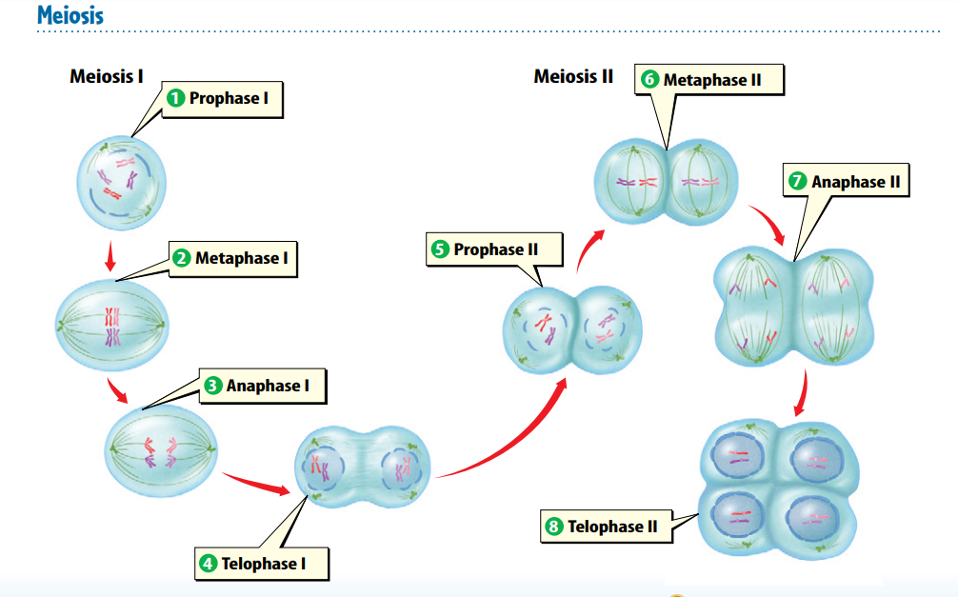
Warm Up 4 min 11/6/18 Tuesday Write the order of Meiosis

Slide 2
Today Agenda
1) Warm Up 4 min
2) Lesson Outline 10 min
3) Video 7 min
4) Plicker 23 min

Slide 3
Lesson Outline for Teaching Lesson 1: Sexual Reproduction and Meiosis
A. What is sexual reproduction?
1. Sexual reproduction produces an offspring when genetic materials from two different sex cells combine.
a. The female sex cell, a(n) egg, forms in an ovary.
b. The male sex cell, a(n) sperm, forms in a testis.
2. During a process called fertilization, an egg cell and a sperm cell join together. The new cell that forms is called a(n) zygote.
B. Diploid Cells
1. Organisms that reproduce sexually make two kinds of cells—body cells and sex cells.
2. Body cells are diploid; they have pairs of chromosomes.
3. If a zygote has too many or too few chromosomes, it will not develop properly.
4. Different organisms have different numbers of chromosomes.
5. Homologous chromosomes are pairs of chromosomes that have genes for the same traits arranged in the same order.

Slide 4
C. Haploid Cells
1. Sex cells are haploid; they have only one chromosome from each pair of chromosomes.
2. In meiosis, one diploid cell divides and makes four haploid cells.
D. The Phases of Meiosis
1.Meiosis involves two divisions of the nucleus and the cytoplasm. These divisions, known as meiosis I and meiosis II, result in four haploid cells.
2. During interphase, the reproductive cell grows and duplicates its chromosomes.
3. During meiosis I, each pair of duplicated homologous chromosomes separates.
4. After meiosis I, the two cells formed during this stage go through a second division of the nucleus and cytoplasm called meiosis II. During meiosis II, sister chromatids separate to produce four haploid cells.
E. Why is meiosis important?
1.Meiosis forms sex cells with the correct haploid number of chromosomes. This maintains the correct diploid number of chromosomes in organisms when sex cells join.
2. Meiosis creates genetic variation by producing haploid cells.

Slide 5
F. How do mitosis and meiosis differ?
1. During mitosis and cell division, a body cell and its nucleus divide once and produce two identical cells.
2. During meiosis, a reproductive cell and its nucleus divide twice and produce four cells––two pairs of identical haploid cells.
G. Advantages of Sexual Reproduction
1. Sexual reproduction produces offspring that have a new combination of DNA. This results in genetic variation among individuals.
2. Genetic variation gives individuals within a population slight differences that might be an advantage if the environment changes.
3. Selective breeding has been used to develop desirable traits in plants and animals.
H. Disadvantages of Sexual Reproduction
1. One disadvantage of sexual reproduction is that organisms have to grow and develop until they are mature enough to produce sex cells.
2. Another disadvantage is that searching for a mate takes time and energy and might expose individuals to predators, diseases, or harsh environmental conditions.

Slide 6
Video 6;45 min
https://www.youtube.com/watch?v=uxDo4hxQhcs

Slide 7
Plicker 23

