Slide 1
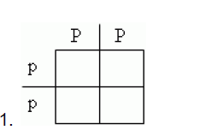
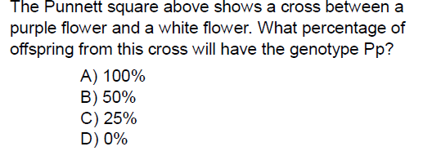
Warm Up 12/12/16 5 minutes

Slide 2
Answer
1)%100

Slide 3
Today Agenda
1) Warm Up 5 minutes
2) What are Pedigree Charts? Video 5 minutes
3) Pedigree Worksheet 15 minutes
4) CK12-Pedigree (15 minutes)
5) Homework/Review (8 minutes)

Slide 4
Video( 5 minutes)
What are Pedigree Charts? Video

Slide 5
Pedigree worksheet (15 minutes)

Slide 6
CK12 (15 minutes)

Slide 7
Homework

Slide 8
Ka-hoot
https://play.kahoot.it/#/?quizId=5b5c498b-b4f6-4d18-983a-807de94cf142

Slide 9
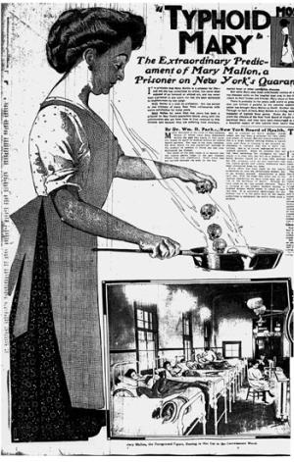
Reading Article (Disease)
Mary Mallon, now known as Typhoid Mary, seemed a healthy woman when a health inspector knocked on her door in 1907, yet she was the cause of several typhoid outbreaks. Since Mary was the first "healthy carrier" of typhoid fever in the United States, she did not understand how someone not sick could spread disease -- so she tried to fight back.
After a trial and then a short run from health officials, Typhoid Mary was recaptured and forced to live in relative seclusion upon North Brother Island off New York.
An Investigation Leads to Mary, the Cook
For the summer of 1906, New York banker Charles Henry Warren wanted to take his family on vacation. They rented a summer home from George Thompson and his wife in Oyster Bay, Long Island. Also for the summer, the Warrens hired Marry Mallon to be their cook.
On August 27, one of the Warren's daughters became ill with typhoid fever. Soon, Mrs. Warren and two maids became ill; followed by the gardener and another Warren daughter.

