Slide 1
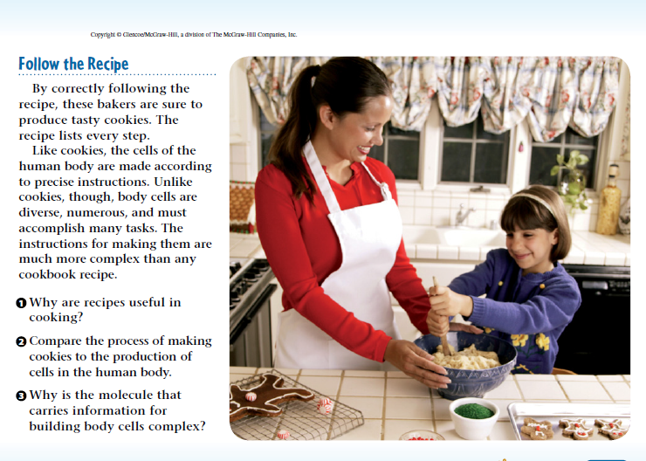
5-12-17 Warm up 5 minutes
1)

Slide 2
Answer of the Warm Up
1 A recipe allows a cook to prepare a dish and be confident of the results. It also lets a cook repeat the successful efforts of others.
2 Both tasks rely on following a set of instructions. However, the task of making the body’s cells is much more complex, and the body accomplishes this task automatically. No thought or decision making is involved.
3 The molecule is extremely complex because it provides the instructions for making all the traits of an organism.

Slide 3
Today Agenda 12/14/17
1) Warm Up 5 minutes
2) Lesson 3 Introduction 5 minutes
3) Bill Nye Science-Genes 25 minutes
4) Presentations 7 minutes

Slide 4
3
DNA and Genetics-Science Journal
Do you agree or disagree?
Any condition present at birth is genetic.
A change in the sequence of an organism’s DNA always changes the organism’s traits.
Answer;
1) Disagree. Not all conditions present at birth are based on genetics. Some may be environmental.
2) Disagree. Some mutations don’t cause changes in proteins, so they don’t affect traits.

Slide 5
3
DNA and Genetics-Science Journal
What is DNA?
What is the role of RNA in protein production?
How do changes in the sequence of DNA affect traits?
1) DNA contains an organism’s genetic information.
2) RNA carries the codes for making proteins from the nucleus to the cytoplasm. RNA also forms part of ribosomes.
3) A change in the sequence of DNA, called a mutation, can change the traits of an organism.

Slide 6
3
DNA and Genetics-Science Journal
DNA
nucleotide
replication
RNA
transcription
translation
mutation

Slide 7
Bill Nye Science
Video 23 minutes
Video worksheet classwork 35 questions.

Slide 8
Presentations

