Slide 1
Warm Up 5 minutes 12/4/17 Monday

Slide 2
Warm Up Answer
1 The peas are all approximately the same size and
shape. They differ in their color and smoothness.
2 Many answers are possible. Varieties of corn have kernels of different colors and size, and they differ in sweetness. Apples can be yellow, red, or green, and they have a variety of tastes. The flesh of watermelons can be red or yellow, seeded or seedless. Dogs and cats, even within the sam breed, can have different fur colors and markings.
3 Yes. A seed grows and develops to become a mature plant, so it must contain the information for the traits of the plant

Slide 3
Today Agenda
1) Warm Up 5 minutes
2) New Chapter Genetic/Heredity ( Introduction) 15 minutes
3) Content Vocabulary 5 minutes
4) Quizlet and Quizlet Live 18 minutes
P.S: No homework this week (STEP 6 and Display Board Design is important- Remember Next week STEP 7 Classroom Presentation)

Slide 4
Genetics
Chapter Introduction
Lesson 1: Mendel and His Peas
Lesson 2: Understanding Inheritance
Lesson 3: DNA and Genetics
Chapter Wrap-Up

Slide 5
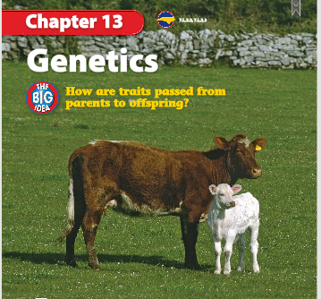
Genetics
How did this happen?
Look at the photo at the beginning of the chapter. The color of this fawn is caused by a genetic trait called albinism. Albinism is the absence of body pigment. Notice that the fawn’s mother has brown hair, the normal fur color of an adult whitetail deer.
Why do you think the fawn looks so different from its mother?
What do you think determines the color of the offspring?
How do you think traits are passed from generation to generation?

Slide 6
Genetics
How are traits passed from parents to offspring?
Inherited genes are the basis of an organism’s traits.

Slide 7
Genetics
Lesson 1: Mendel and His Peas
Mendel performed cross-pollination experiments to track which traits were produced by specific parental crosses.
Mendel found that two factors—one from a sperm cell and one from an egg cell—control each trait.
Dominant traits block the expression of recessive traits. Recessive traits are expressed only when two recessive factors are present.

Slide 8
Genetics
Lesson 2: Understanding Inheritance
Phenotype describes how a trait appears.
Genotype describes alleles that control a trait.
Punnett squares and pedigrees are tools to model patterns of inheritance.
Many patterns of inheritance, such as codominance and polygenic inheritance, are more complex than Mendel described.

Slide 9
Genetics
Lesson 3: DNA and Genetics
DNA contains an organism’s genetic information.
RNA carries the codes for making proteins from the nucleus to the cytoplasm. RNA also forms part of ribosomes.
A change in the sequence of DNA, called a mutation, can change the traits of an organism.

Slide 10
Content Vocabulary 5 minutes
Dominant trait genetic factor that blocks another genetic factor
Egg: haploid sex cell formed in the female reproductive organ
Genetics: study of how traits are passed from parents to offspring
Heredity: passing of traits from parents to offspring hybrid offspring of two plants or animals with different forms of the same trait
Recessive trait genetic factor that is blocked by the presence of a dominant factor
Sperm: haploid sex cell formed in the male reproductive organs
Answer order of content vocabulary
1) Heredity
2) Genetics
3) Hybrid
4) Egg
5) Sperm
6) Dominant trait
7) Recessive trait

Slide 11
Quizlet
You are www.quizlet.com
Click sign in (log in)
You have study set ; Mendel and his peas
https://quizlet.com/136395499/mendel-and-his-peas-flash-cards/
Study the flash card, write, spell and take the test.
You can play match and gravity game
We are going to play quizlet.live last 10 minutes

