Slide 1
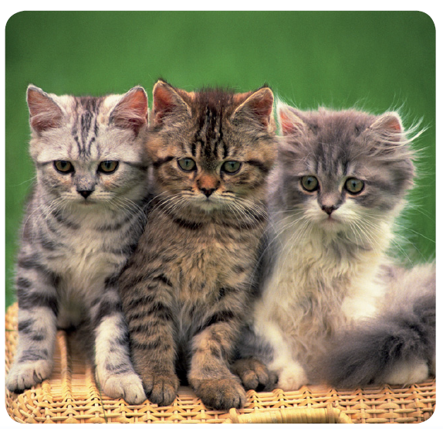
Warm Up 4 min
Born Cute
These adorable kittens did not
choose the color of their fur or
the shapes of their faces. These
traits were determined before
they were born. The body of each kitten carries information to make brown or gray fur, green eyes, pointy ears, and white whiskers. In fact, this information makes these animals cats, instead of other animals.
How are these kittens alike? How are they different?
Answer:
All the kittens have similar body sizes and shapes, and their fur is approximately the same length. They differ in their fur colors and markings.

Slide 2
Today Agenda
1) Warm Up 4 min
2) Lesson Outline (Understanding Inheritance- Lesson 2) 10 min
3) Video
4) Plicker 25 min

Slide 3
Lesson Outline-Lesson 2: Understanding Inheritance
A. What controls traits?
1. Inside each cell is a nucleus that contains threadlike structures called chromosomes.
2. Mendel’s factors are parts of chromosomes, and each cell in offspring contains chromosomes from both parents.
3. A(n) gene is a section on a chromosome that has genetic information for one trait.
4. The different forms of a gene are called alleles.
5. Geneticists refer to how a trait appears, or is expressed, as the trait’s phenotype.
6. The two alleles that control the phenotype of a trait are called the trait’s genotype.
a. In genetics, uppercase letters represent dominant alleles, and lowercase letters represent recessive alleles.
b. When two alleles of a gene are the same, its genotype is homozygous.
c. If two alleles of a gene are different, its genotype is heterozygous.

Slide 4
B. Modeling Inheritance
1. In a situation based on chance, such as flipping a coin, the chance of getting an outcome can be represented by a(n) ratio such as 50:50, or 1:1.
2. A(n) Punnett square is a model that is used to predict possible genotypes and phenotypes of offspring.
a. To create a Punnett square, you need to know the genotype of both parents.
b. If you count large numbers of offspring from a particular cross, the overall ratio will be close to the ratio predicted by a Punnett square.
3. A(n) pedigree is a diagram that shows phenotypes of genetically related family members. It also gives clues about their genotypes.

Slide 5
C. Complex Patterns of Inheritance
1. Alleles show incomplete dominance when the offspring’s phenotype is a blend of the parents’ phenotypes.
2. Alleles show codominance when both alleles can be observed in a phenotype.
3. Unlike the genes in Mendel’s pea plants, some genes have multiple alleles.
4. ABO blood type is a trait that is determined by multiple alleles.
5. Polygenic inheritance occurs when multiple genes determine the phenotype of a trait.
6. Human eye color is an example of polygenic inheritance.
D. Genes and the Environment
1. Genes are not the only factors that can affect phenotypes. An organism’s environment can also affect its phenotype.
2. The flower color of one type of hydrangea is determined by the soil in which the hydrangea grows.
3. Healthy choices can affect a person’s phenotype.

Slide 6
Video- Heredity 2:50 min
https://www.brainpop.com/health/geneticsgrowthanddevelopment/heredity/

Slide 7
Plicker
10 questions.

