Slide 1
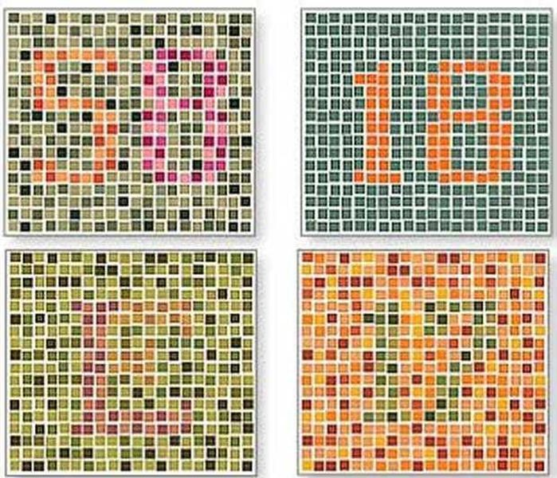
Warm Up 4 min 1/16/19 Wednesday
What is colorblindness? How does a person become colorblind?
Answer: Color blindness is a usually a genetic (hereditary) condition Red/green and blue color blindness is usually passed down from your parents.

Slide 2
Today Agenda
1) Warm up 4 min
2) NearPod Activity 40 min

Slide 3
Nearpod-40 min
1) You will go to www.nearpod.com
2) You have a class code (You don’t need to sign up) just put the code and put your first and last name.
SWZRI- Bluford
JVQYB- Gursey
HCNQP- McNair
3) You will finish the assignment and I will see your score on my system.
4) Put your real name.

