Slide 1
Warm Up 5 minutes
…… is the main function of the respiratory system
Breathing(B)
2) The ….. Is a part of the respiratory system .
Voice box (A)
3)Cigarette smoke forms a sticky coating over the ….. In the respiratory system
Cilia(C)

Slide 2
Today Agenda
1) Warm up 5 minutes
2) Instruction (Brain Pop Vocabulary)
3) Video Notes
4) Kidneys: The body’s Filter
5) Pop Quiz
6) Video (Life choices and personal wellness)
7) Homework

Slide 3
Brain Pop Definition

Slide 4
Video Notes
1) The main function of the urinary system removing poisons from your body
2) Kidney is bean like organ which help urinary system
3) 1-Urea enter the kidney 2-Urine passes through the ureters. 3-Urine enters the urethra
4) Before the kidneys filter out urea exist in your bloodstream.
5) Urine is mostly water.
6) Your bladder and balloon in common they can both expand.
7) If your bladder lacked shphincter muscles , urine might leak out of your bladder.
8) the main function of the urethra delivers urine from the bladder to the outside world
9) How full the bladder is determine bathroom time
10) Nephrons is filter like structures in the kidney.

Slide 5
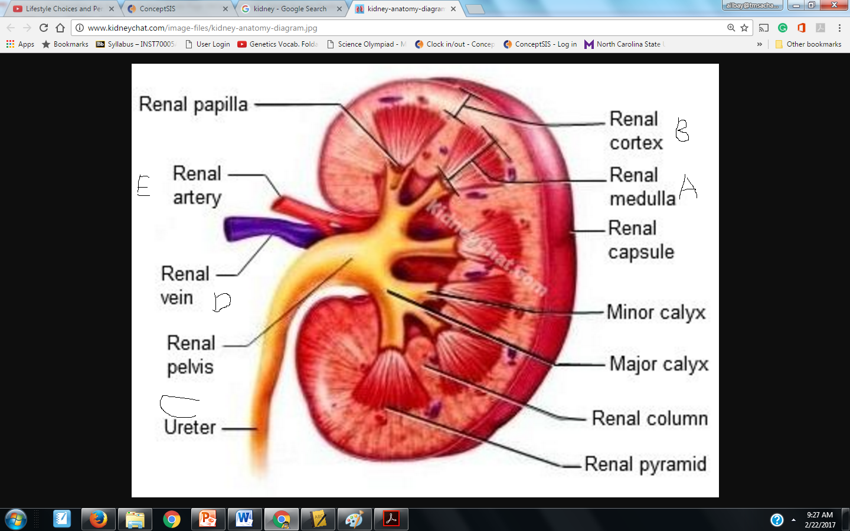
Kidneys: The body’s Filters
You can read background information
You can also use Page 212-215 on your textbook.
You have 10 minutes

Slide 6
Pop Quiz

Slide 7
Video

Slide 8
Homework
The excretory System article- 5 question

