Slide 1
Warm up 4 min 2 28 19 Thursday
What are the disorders of digestive system?
Answer;
Diarrhea, gas, stomach pain, and stomach cramps, ulser, Gastroesophageal reflux disease.

Slide 2
Today Agenda
1) Warm Up 4 min
2) Group Activity 25 min
3) Group Project Time 15 min
Important Reminder
Digestive System Foldable Weekly Homework 3/1/19 Friday
Student Group Presentation Digestive System (Bryce, Salma, Michael, Naiah, Kaleb)

Slide 3
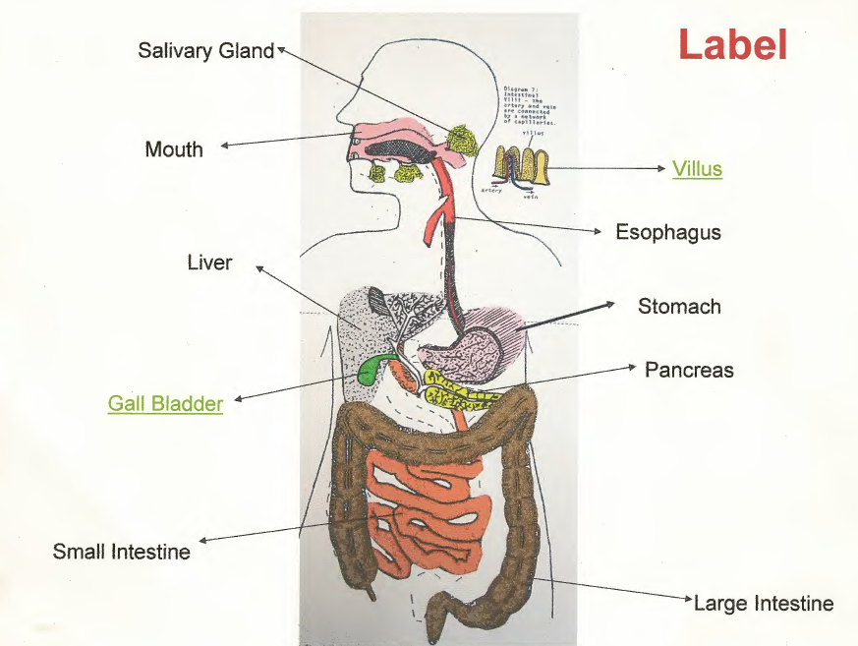
Group Activity- 25 min
Pancreas: Yellow
Liver: Gray
Small Intestine: orange
Stomach: Pink
Gall Bladder: green
Villus: light brown
Artery: red
Vein: blue
Large Intestine: brown
Esophagus: red
Mouth: pink
Salivary Glands (3): yellow
50 points for correct color code
50 points for correct FUNCTION
of each organ of the digestive
system

Slide 4
Video 2;35
https://www.brainpop.com/health/bodysystems/digestivesystem/

Slide 5
Group Project Time
1) In your Group Project there are minimum 8 slide show
2) One for the tittle and group member name, one slide for the diagram and one slide for a video under 5 min
3) Rest of the five slides will about the questions answer.
4) You will come together now and work on the google slide (You can work at the same time if you share the document )
5) Remember your due dates for the presentation.
6) Add Kahoot or Quizizz as last slide of your presentation (it will graded) `

