Slide 1
2/5/19 Tuesday 4 min
1)What are skeletal system parts?
Answer;
Bones work in concert with tendons, joints, ligaments, and skeletal muscles to produce various movements.

Slide 2
Today Agenda
1) Warm Up 4 min
2) Group Work 40 min
1) Weekly Homework (Skeletal System Foldable due is Friday)
2) Skeletal System Student Presentation is this Friday.
3) Movement Quiz (Muscular, Skeletal, and Integumentary) this Friday.
4) Science Field Trip 14th February permission slip and money due is this Friday. (For A and B Honor all students)

Slide 3
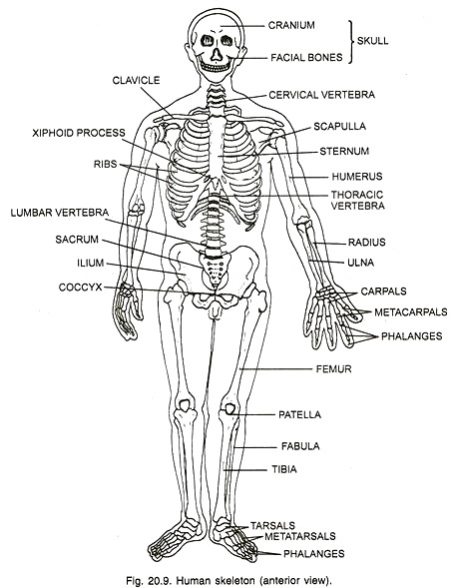
Group Work-15 min
You have 15 min work together and answer all four pages work. You are not allowed to go get answer other group( your group members only)
Random group will check each others answer.

Slide 4
Group Work Answer- Fill In the Blank
Bones
Skeletal
Protect
Cranium
Ribcage
Shape
Skeleton
Jellyfish
Ligaments
Move
Tendon
Minerals
Blood
Marrow

Slide 5
Crossword
1) tendon
2) vertebrae
3) ligament
4) joint
5) shoulderblade
6) tibia
7) femur
8) jawbone
9) breastbone
10) marrow
11) ribcage
12) radius
13) skull
14) ulna
15) collarbone
16) fibula
17)spine
18) humerus

Slide 6
Joints of the Skeleton- Answer Key
1) where two bones come together
2) ligament
3) cartilage
4) movable and inmovable
5) One can move( Movable) one cannot (Inmovable)
6) Back and forward- Hinge, pivot 360, gliding-slide and ball and socket (rotation)
7) hinge and gliding, ball and socket and pivot
8) knee and finger and ankle
9) Hinge- Back and forward Ankle Ball and socket- rotate- shoulder Pivot-Neck Gliding- Wrist (slide each other)
10) a) hinge b) gliding c) hinge d) hinge e) gliding f) pivot

