Slide 1
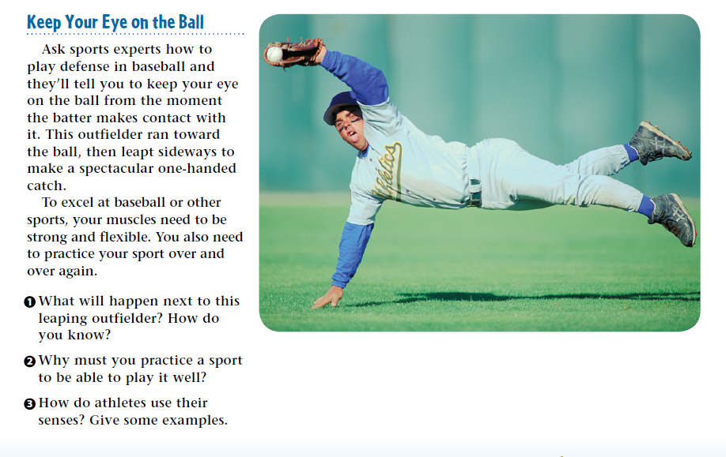
3/26/19 Tuesday 3 min

Slide 2
Warm Up Answer
1) The outfielder will fall to the ground, ideally with the ball still in his glove. Gravity
2) Practicing a sport teaches the mind and body
the required movements and reactions the sport
demands.
3) Sight is used to watch a ball or to find someone to throw the ball to.

Slide 3
Today Agenda
1) Warm Up 3 min
2) Lesson Outline 15 min
3) Video 5 min
4) Plicker 20 min
Important Reminder
No weekly homework but study guide
Unit Test on Thursday
Last day of 3rd Quarter is Thursday no school on Friday.

Slide 4
Lesson 1 Outline
A. The Body’s Organization
1. Organ systems are groups of organs in the body that work together to form a specific task.
2. Organ systems work together to maintain homeostasis, or steady internal conditions, even when external conditions change.
B. Digestion and Excretion
1. Food is broken down in the body during digestion.
a. After food enters the mouth, chewing breaks food into smaller parts.
b. Saliva, which contains enzymes, also helps the mouth break down food.
2. When you swallow, food, water, and other liquids move into the esophagus, a hollow tube that connects the mouth to the stomach.
3. From the stomach, food next moves into the small intestine, which has functions of digestion and absorption.
4. The large intestine, or colon, receives digested food that the small intestine did not absorb and absorbs water from the remaining waste material.
5. Nutrients are the parts of food needed for the body to grow and survive.
a. Nutrition labels on food show the amount of each nutrient in a food.
b. Nutrients in absorbed food contain energy, which is measured in Calories.
6. After digestion, substances that are not used are removed by the excretory system, which includes the lungs, skin, liver, kidneys, bladder, and rectum

Slide 5
C. Respiration and Circulation- Lesson Outline 1
1. The respiratory system exchanges gases between the body and the environment. Oxygen enters the body when you inhale. Carbon dioxide leaves the body when you exhale.
2. The heart, blood, and blood vessels make up the circulatory system.
a. Your heart is made up of muscle cells that constantly contract and relax, pumping blood to the rest of your body.
b. Blood travels through your body in tiny tubes called (blood) vessels.
c. The three main types of blood vessels are arteries, veins, and capillaries.
3. Blood contains red blood cells, platelets, and white blood cells.
a. The liquid part of blood is called plasma.
b. Red blood cells carry oxygen, and white blood cells protect the body from infection and disease.
c. Platelets help the body heal when you get a cut.
d. Scientists classify the proteins found on the surface of red blood cells into groups called blood types, which include, type A, type B, type AB, and type O.

Slide 6
C. Respiration and Circulation- Lesson Outline 1
4. The tonsils, the spleen, the thymus, bone marrow, and lymph nodes are part of the lymphatic system. The lymphatic system has three main functions—removing excess fluid, producing white blood cells, and absorbing and transporting fats.
5. Protection from infection or toxins is called immunity.
a. The skeletal system produces immune cells, and the circulatory system transports them throughout the body.
b. As part of the first line of defense, skin and mucus prevent toxins and other substances from entering the body.
c. During the second line of defense or the immune response, white blood cells attack and destroy harmful substances.
d. The third line of defense includes antibodies and vaccines, which help fight pathogens that have infected the body.

Slide 7
Lesson 2: Structure, Movement, and Control
A. Structure and Movement
1. The skeletal system includes bones, ligaments, tendons, and cartilage.
2. The skeletal system protects internal organs, provides support, aids body movement, and stores minerals.
a. The element calcium, which is required for healthy muscular and nervous systems, is stored in bones.
b. The skeleton gives your body structure and support.
c. Your brain is protected by the skull, which is one way bones protect organs.
d. The skeleton works with the muscular system to help the body move.
3. Bones contain two types of tissue.
a. The hard, outer part of the bone is called compact bone.
b. The bone tissue that contains many holes is called spongy bone.
c. Some bones also contain bone marrow, which is a part of the lymphatic system and makes white blood cells.
4. Almost half of your body mass is muscle cells, which make up the muscular system.
a. The type of muscle tissue that works with the skeletal system to help you move is skeletal muscle.
b. Tendons connect skeletal muscles to bone.
c. Muscle in the heart is cardiac muscle.
d. Smooth muscle tissue is in organs

Slide 8
B. Control and Coordination
1. The nervous system detects, processes, and responds to information in the body.
a. The basic unit of the nervous system is the nerve cell, also called a(n) neuron.
b. The central nervous system contains the brain and the spinal cord.
c. Nerves outside the brain and spinal cord make up the peripheral nervous system.
d. Information entering the body through neurons is sent to the central nervous system.
e. After the central nervous system processes the information, it sends signals to the peripheral nervous system.
f. Functions, such as breathing and digestion, are automatic, or involuntary, and do not require you to think about them to make them happen.
g. Many functions of the nervous system require you to think about them to make them happen and are called voluntary.

Slide 9
B. Control and Coordination
h. Automatic movements in response to a signal are called reflexes. Signals for these movements are processed by the spinal cord, not the brain.
i. Humans detect their external environment by using five senses—vision, touch, hearing, taste, and smell.
2. The endocrine system uses hormones to communicate with other organ systems.
a. Hormones are chemical signals sent from the organs of the endocrine system.
b. Hormones take longer to send a signal than nerves do, but the effect lasts longer.
c. The endocrine system works with other body systems to maintain homeostasis.

Slide 10
Video 5 min
https://www.youtube.com/watch?v=Ae4MadKPJC0

Slide 11
Plicker
15 min (Study Guide part 1)

