Slide 1
Warm Up 3 min 3/27/19 Wednesday
Write two facts you learned during your human body system presentation.
Write one thing you want to do differently for the next time. (presentation)

Slide 2
Today Agenda
1) Warm Up 3 min
2) Content Practice 15 min
3) Video 5 min
4) Plicker 20 min
Important Reminder
No weekly homework but study guide
Unit Test on Thursday
Last day of 3rd Quarter is Thursday no school on Friday.

Slide 3
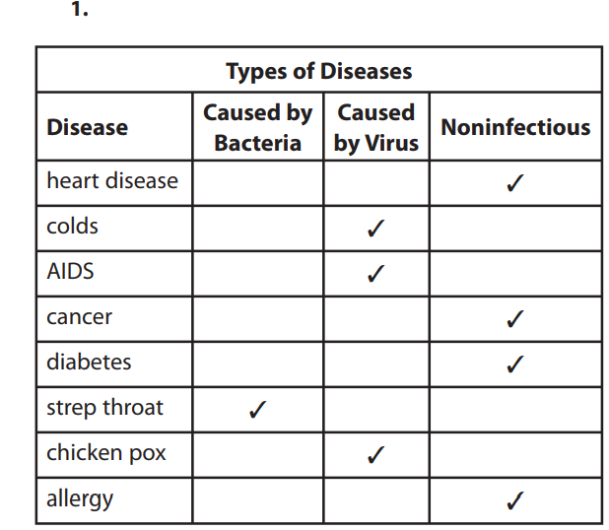
Content Practice A Page 13
2)
First: Students’ drawings should show two student-determined-and-labeled shapes—a lymphocyte (or labeled as a white blood cell) and a bacteria.
Next: Students’ drawings should indicate the lymphocyte engulfing the bacteria.
Last: Students’ drawings should show the bacteria completely engulfed by the lymphocyte.

Slide 4
Content Practice B Page 14
1. to break down food so nutrients can be absorbed by the body.
-the salivary glands, tongue, esophagus, stomach, liver, pancreas, gallbladder, large intestine, small intestine, and rectum.
2. to remove solid, liquid, and gas waste from the body.
-the lungs, skin, kidneys, bladder, and rectum.
3. The respiratory system takes in oxygen and releases carbon dioxide.
4. The circulatory system transports nutrients, gases, wastes, and other substances through the body.
5. The lymphatic system removes excess fluid around the organs, produces white blood cells, and absorbs and transports fats.
6. Immunity is the body’s protection from infection or toxins.

Slide 5
Content Practice A (page 33)
1–7. (any order) bones, cardiac muscle, cartilage, ligaments, skeletal muscle, smooth muscle, tendons
8–14. (any order) brain, central nervous system, endocrine system, hormones, neurons, senses, spinal cord
15. Together, the nervous and endocrine systems receive and process information about the internal and external environments and control many body functions, including movement, communication, and growth.

Slide 6
Content Practice B (page 34)
1. Muscle and nervous systems would not work properly Bones would also become much weaker.
2. There would be no structure to the body
3. The heart would stop working, and blood would stop flowing in the body.
4. There would be a problem with the absorption of nutrients.
5. Organ systems would not work properly. Growth and development might not progress normally.
6. Voluntary and involuntary control would be affected.
7. Information could not be sent to or from the spinal cord.
8. The muscle connected to the bone by that tendon would not function properly.

Slide 7
Video
https://www.youtube.com/watch?v=gEUu-A2wfSE

Slide 8
Plicker
Study Guide Part 2 ( 15 questions)

