Slide 1
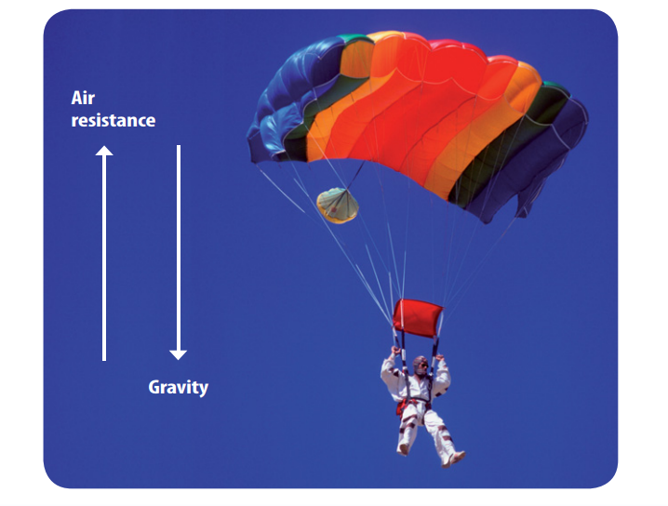
4/13/18 Friday 3 min Bell Ringer 1)Describe what you see in this picture.

Slide 2
Today Agenda
1) Warm Up 3 min
2) 5 min Video Law of Motion (1st Law of Motion)- 5 min
3) Ck12- 15 min
4) Brain Pop 15 min
5) Kahoot 10 min

Slide 3
Video- 5 min
https://www.youtube.com/watch?v=LFudFdF50yI
And instruction

Slide 4
Ck12- 15 min
1) Go to www.ck12.org
2) You have 3 assignment on there. Each assignment worth 33.3 points.
3) When you got a trophy let me know for grade and grade scientist point.
4) Your login; firstnametmsa
Password; tmsa2017

Slide 5
Brain Pop-15 min
1) You have 3 assignment
2) Video
3) Video Quiz
4) Concept Map
Each assignment 33 point.

Slide 6
Kahoot- 10 min
First Law of Motion
https://play.kahoot.it/#/?quizId=8507d746-da66-4e44-8a90-e015b36795b3

