Slide 1
Warm Up 5 minutes 4-18-17
1)A ball is motionless on the floor. Which best explains this?
A. No friction is acting on the ball.
B. The inertia on the ball is too low.
C. The friction on the ball is too high.
D. No unbalanced force is being applied to the ball.
Answer; D

Slide 2
Today Agenda
1) Warm Up 5 minutes
2) Instruction time 10 minutes
3) Interactive Video
4) Video Questions
5) Homework

Slide 3
Lesson Objectives
Define force, and give examples of forces.
Describe how forces combine and affect motion.
Lesson Vocabulary
• force
• net force
• newton (N)

Slide 4
Introduction
Any time the motion of an object changes, a force has been applied. Force can cause a stationary object to start moving or a moving object to accelerate. The moving object may change its speed, its direction, or both.
How much an object’s motion changes when a force is applied depends on the strength of the force and the object’s mass.

Slide 5
Defining Force
Force is defined as a push or a pull acting on an object. Examples of forces include friction and gravity.
Another example of force is applied force . It occurs when a person or thing applies force to an object, like the boy pushing the swing

Slide 6
Force as a Vector
Force is a vector because it has both size and direction.
Like other vectors, forces can be represented with arrows

Slide 7
SI Unit of Force
The SI unit of force is the newton (N). One newton is the amount of force that causes a mass of 1 kilogram to
Accelerate at 1 m/s2. Thus, the newton can also be expressed as kg·m/s2. The newton was named for the scientist Sir Isaac Newton, who is famous for his law of gravity

Slide 8
Combining Forces
More than one force may act on an object at the same time.
In fact, just about all objects on Earth have at least two forces acting on them at all times. One force is gravity, which pulls objects down toward the center of Earth. The other force is an upward force that may be provided by the ground or other surface.

Slide 9
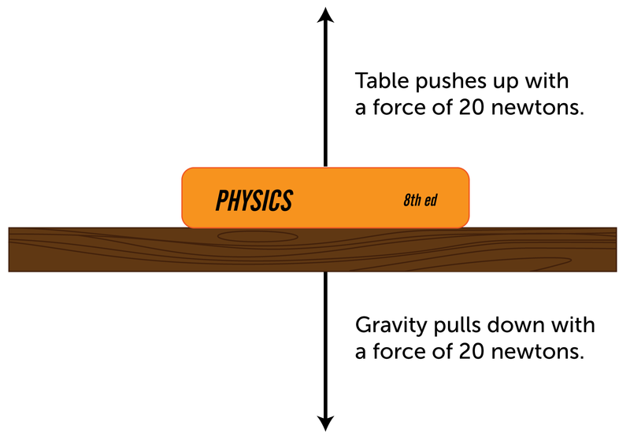
Net Force
The combined forces acting on the book — or any other object — are called the net force.

Slide 10
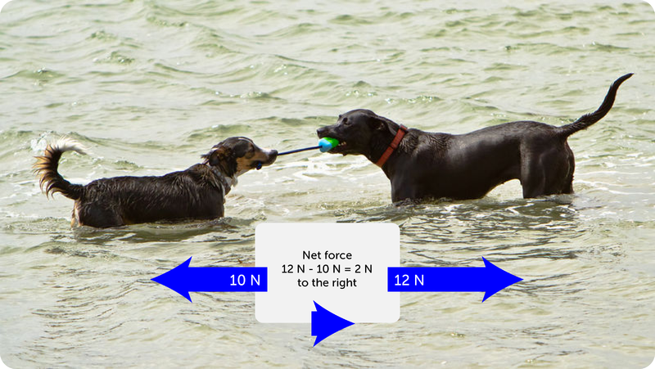
Forces Acting in Opposite Directions
When two forces act on an object in opposite directions the net force is equal to the difference between the two forces.

Slide 11
When two forces are applied to an object in the same direction, the two forces are added to yield the net force

Slide 12
Lesson Summary •
Force is a push or a pull acting on an object. Examples of force include friction and gravity. Force is a vector because it has both size and direction. The SI unit of force is the newton (N).
The combined forces acting on an object are called the net force. When forces act in opposite directions, they are subtracted to yield the net force. When they act in the same direction, they are added to yield the net force.

Slide 13
Lesson Review Questions
1. Define force. Give an example of a force.
2. What is a newton?
3. What is net force?
4. Describe an example of balanced forces and an example of unbalanced forces.

Slide 14
Apply Concepts
5. What is the net force acting on the block in each diagram below?

Slide 15
Interactive Video
Question
Homework (Pull or Push)

Slide 16
Chromebook

