Slide 1
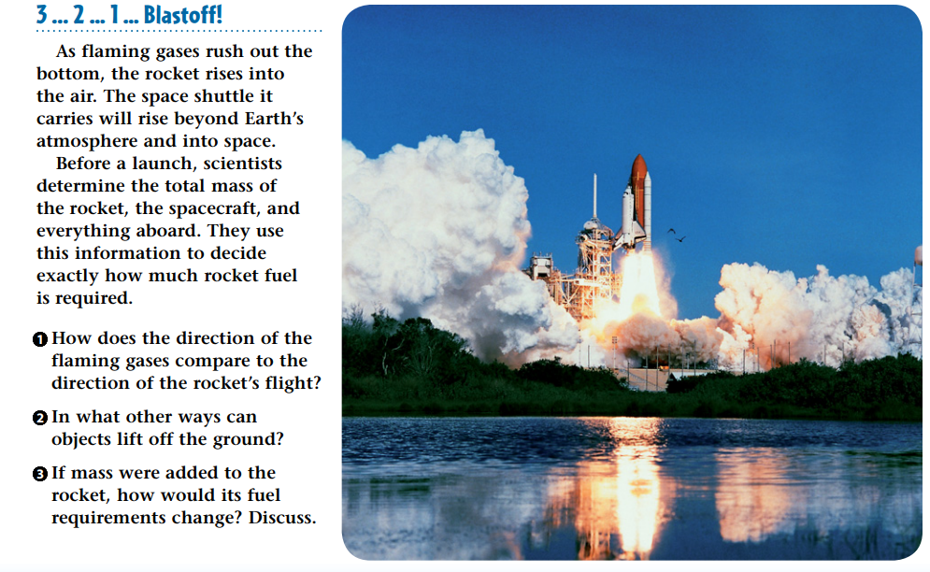
3/18/18 Wednesday Warm Up 5 min

Slide 2
Warm Up Answer
1 The gases and the rocket move in opposite directions.
2 Answers include a person jumping; a person physically lifting an object; a force propelling an object upward (such as a golf club striking a golf ball); and a lifting force generated by the air (such as the forces that lift a hot-air balloon and an airplane
3 More fuel would be needed. If the rocket had a greater mass, a greater force would be needed to lift it.

Slide 3
Today Agenda
1) Warm Up 5 minutes
2) Flocabulary Lyric 5 min
3) Flocabulary Activity- 15 min
4) Open notebook Quiz 15 min
5) Homework

Slide 4
Flocabulary – 20 min
1) Video Lyric 5 min
2) Flash Card 5 min
3) Read to Learn 5 min
4) Video Quiz 5 min
5) Lyric Lab- (Optional if you get 80 or above on quiz)
If you are done , you can go socrative and take your open note quiz.

Slide 5
Socrative- 15 min
Open Notebook Quiz
Go to www.socrative.com
Click student login
Room Name; texasam. umad, caltech1, berkeley1, bosphorus
Your student ID is your plicker number
15 questions.

