Slide 1
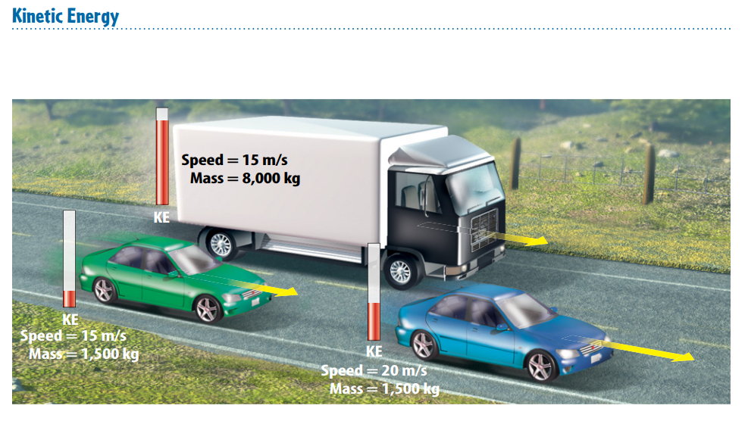
Warm Up 5 minutes 4/24/18 Tuesday
Compare their kinetic energy based on their mass and speed.

Slide 2
Today Agenda
1) Warm Up 5 minutes
2) Lesson 1; Forms of Energy Introduction- 10 min
3) Lesson Outline 10 min
4) Content Practice 15 min
5) Video and Review 5 min
6) Homework; Content Vocabulary 3 min

Slide 3
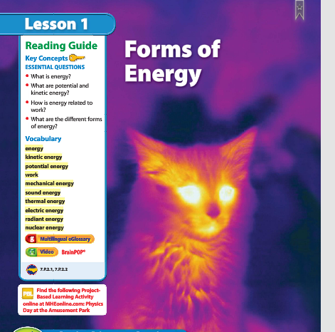
1
Forms of Energy
Why is this cat glowing?
Look at the photo at the beginning of the lesson. A camera that detects temperature made this image. Dark colors represent cooler temperatures and light colors represent warmer temperatures. Temperatures are cooler where the cat’s body emits less radiant energy and warmer where the cat’s body emits more radiant energy.

Slide 4
Lesson Vocabulary 10 min
Electric energy: energy an electric current carries
Energy: ability to cause change
Kinetic energy: energy due to motion
Mechanical energy: sum of potential energy and kinetic energy in a system of objects
Nuclear energy: energy that is stored and released in the nucleus of an atom
Potential energy: stored energy due to interactions between objects or particles
Radiant energy: energy that electromagnetic waves carry; sometimes called light energy
Sound energy: energy that sound carries
Thermal energy: sum of kinetic energy and potential energy of the particles that make up an object
Work: energy transfer that occurs when a force makes an object move in the direction of the force while the force is acting on the object

Slide 5
Lesson Outline-Lesson 1: Forms of Energy
A. What is energy?
1. Energy is the ability to cause change.
2. Energy can cause an object to change its position or its motion.
B. Kinetic Energy—Energy of Motion
1. Energy due to motion is kinetic energy.
2. The faster an object moves, the more kinetic energy it has.
3. The kinetic energy of an object depends on its mass as well as its speed.
4. If two objects move at the same speed, the object with the greater mass will have more kinetic energy.

Slide 6
C. Potential Energy—Stored Energy
1. Potential energy is stored energy.
2. When you are holding a book, energy is stored between the book and Earth; this type of energy is called gravitational potential energy. This type of potential energy stored between an object and Earth depends on the weight and height of the object.
3. Elastic potential energy is energy stored in objects that are compressed or stretched.
4. When you stretch a rubber band, you are storing elastic potential energy. When you let go of the rubber band, the stored potential energy is transformed into kinetic energy.
5. Food has chemical potential energy, which is the energy stored in the bonds between atoms. This energy is released when chemical reactions occur.

Slide 7
D. Energy and Work
1. Work is the transfer of energy that occurs when a force is applied over a distance.
2. Energy is sometimes described as the ability to do work.
E. Other Forms of Energy
1. Energy can be measured in units of joules.
2. Mechanical energy is the total kinetic energy and potential energy in an object or group of objects.
3. The energy carried by sound waves is sound energy. It is produced by objects that vibrate.
4. All materials are made of atoms and molecules that are always moving. The energy of atoms and molecules due to their motion is thermal energy.

Slide 8
E. Other Forms of Energy
5. Electrical energy is the energy carried by an electric current.
6. Electromagnetic waves, such a microwaves, can travel through a vacuum.
7. The energy of electromagnetic waves is called radiant energy.
8. Nuclear energy is stored in the nucleus of an atom.
9. The Sun releases nuclear energy when the nuclei of atoms join together.
10. Nuclear power plants release energy by splitting nuclei.

Slide 9
Content Practice A-B 15 min
This is an independent work.
There are 18 questions and each of them 5.5 point.
You have 15 minutes to finish.
If you need additional time let me know.
Thank you.

Slide 10
1
Forms of Energy
A fast-moving baseball has more kinetic energy than a slow-moving baseball.
Agree. The faster an object moves, the more kinetic energy it has, so the fast-moving baseball would have more energy.

Slide 11
1
Forms of Energy
A large truck and a small car moving at the same speed have the same kinetic energy.
Disagree. A large truck moving at the same speed as a small car has more kinetic energy than the car. The kinetic energy (KE) of an object depends on its speed and its mass.

Slide 12
1
Forms of Energy
A book sitting on a shelf has no energy.
Disagree. A book sitting on a shelf has thermal energy. Also, there’s gravitational potential energy between the book and Earth.

Slide 13
Homework
Content Vocabulary

