Slide 1
Warm Up 5 minutes
Bumper cars an example of Newton’s third law . Explain
The law of interaction, says that if one body exerts a force on a second body, the second body exerts a force equal in magnitude and opposite in direction on the first body

Slide 2
Today Agenda
1) Warm Up 5 minutes
2) Homework check
3) Lesson Summary
4) Study Guide for the Newton’s Law of Motion (With the video Study Jams)
5) Game

Slide 3
Answers
1) F
2) T
3) F
4) F
5) F
6) B
7) Warm Up

Slide 4
A roller coaster is a good example of more than one of Newton’s law of motion. Explain
1)The roller coaster in motion continues to move with constant velocity unless acted upon by an unbalanced force. 2)when you drop from a great height in a roller coaster 3)When the train goes through a banked track, you will feel as though there is a 'push' from the seats of the train acting on you.

Slide 5
Study Guide 20 min
1) First Law of Motion (Page 502) 2) First Law of Motion (Page 504)
3) Balanced Force (Page 466)
4) Unbalanced Force (Page 467)
11) Type of friction (Page 472)
12) Page 505
13) Page 481
14) Page 507

Slide 6
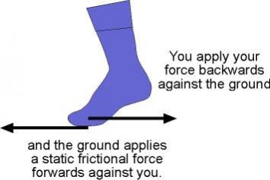
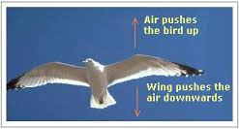
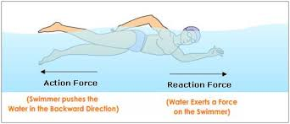
Study Guide Answer

Slide 7
Video 15 minutes
Study Guide for Newton’s Law of motion
1) Study Jams-Video 1st law
2) 2nd Law
3) 3rd Law

Slide 8
Newton’s Law of Motion Games
GAMES
Acceleration - Follow the instructions to fill out the chart and then see if you can write a rule.
3 Puck Cluck - An online game of collisions and decisions.
3 Ball Football - Now try your skills in the real world.

