Slide 1
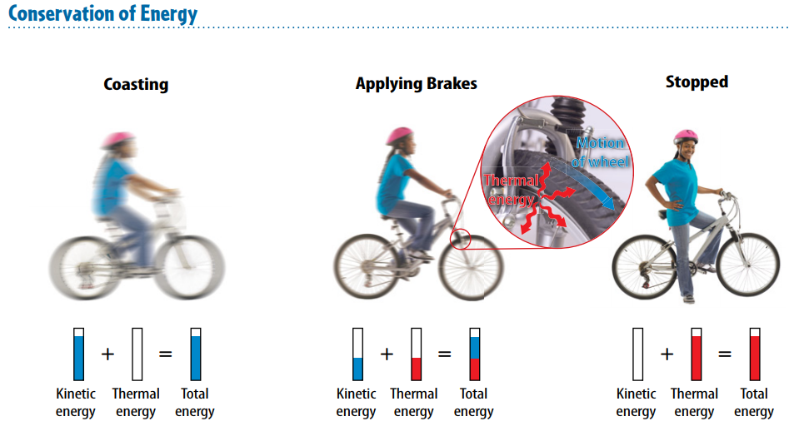
Warm Up 5 minutes 5-1-18 Tuesday
Explain the process in the picture. How energy conservation occurred?

Slide 2
Today Agenda
1) Warm Up 5 minutes
2) Quizlet Online Assignment 25 minutes
3) Quizlet Live 15 minutes
4) Homework 3 minutes

Slide 3
Quizlet Online Assignment 25 minutes
You are going to Quizlet.com
Click search button my name ahmetilbay or search tmsa. 1) Learn 2) Flash Card 3) Write 4) Spell 5) Test 6) Match (Test will be your grade)

Slide 4
Quizlet Live- 15 minutes
Go to www.quizlet.live
Wait for the code
You can pick your own team or random team.

Slide 5
Homework
Intro the Energy worksheet- Part 1

