Slide 1
Homework Check
1. A machine is any device that makes doing
work easier.
2. The work that occurs as a result of input force is called input work.
3. In this case, the output force of the
screwdriver is greater than the input force.
4. No; the efficiency can never be 100 percent.

Slide 2
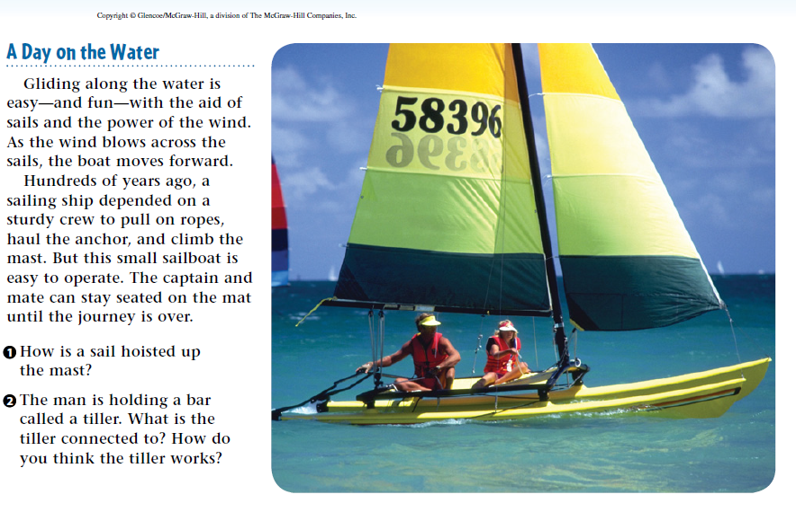
Warm Up 5 minutes 5/10/18 Thursday

Slide 3
Warm Up Answer
1.The crew uses a pulley to hoist the sail. The wheel of the pulley is mounted at the top of the mast, and one end of the rope is connected to the sail.
2 The tiller is connected to a board called the rudder that extends into the water. As the man moves the tiller to the left or right, the rudder moves as well. The force of the water on the rudder helps steer the boat.

Slide 4
Today Agenda
1) Warm Up 5 minutes
2) Lesson Vocabulary 5 minutes
3) Lesson Outline 10 minutes
4) Content Practice- Guided Practice 10 min
5) Brain Pop Simple Machine and Video 17 min
6) No homework

Slide 5
Lesson 3 Vocabulary
fulcrum point about which a lever pivots, or rotates
inclined plane flat, sloped surface
lever made up of a bar that pivots about a fixed point
pulley grooved wheel with a rope or cable wrapped around it
screw inclined plane wrapped around a cylinder
simple machine a machine that does work using only on movement
wedge sloped surface that moves
wheel and axle made up of a shaft, or axle, attached to the center of a wheel such that both rotate together

Slide 6
Lesson 3: Simple Machines Lesson Outline
A. What is a simple machine?
1. A(n) simple machine is a machine that does work using only one movement.
2. These machines do work in a(n) single motion.
B. Levers
1. A(n) lever is a simple machine made of a bar that pivots or rotates about a fixed point.
2. The point that a lever pivots on is called a(n) fulcrum.
3. The distance from the fulcrum to the input force is the input arm; the distance from the fulcrum to the output force is the output arm.
4. With a first-class lever, the fulcrum is between the input force and the output force.
5. With a second-class lever, the output force is between the input force and the fulcrum.

Slide 7
A. What is a simple machine?
6. With a third-class lever, the input force is between the output force and the fulcrum.
7. The ideal mechanical advantage of a lever equals the length of the input arm divided by the length of the output arm.
a. The mechanical advantage of a(n) first-class lever can vary, depending on the location of the fulcrum.
b. In a second-class lever, the input arm is always longer than the output arm; therefore the mechanical advantage is always greater than 1.
c. In a third-class lever, the input arm is always shorter than the output arm; therefore the mechanical advantage is always less than 1.
8. In the human body, muscles provide force for the levers.
a. The neck is a(n) first-class lever, with the neck muscles providing the input force.
b. The foot is a(n) second-class lever, and the arm is a(n) third-class lever.

Slide 8
C. Wheel and Axle
1. A(n) wheel and axle is an axle attached to the center of a wheel and both rotate together.
2. For a wheel and axle, the length of the input arm is the radius of the wheel; the length of the output arm is the radius of the axle.
D. Inclined Planes
1. A(n) inclined plane is a flat, sloped surface.
2. The ideal mechanical advantage of an inclined plane is the length of the inclined plane divided by its height.

Slide 9
D. Inclined Planes
3. A sloped surface that moves is called a(n) wedge.
4. A(n) screw is an inclined plane wrapped around a cylinder.
5. A(n) pulley is a simple machine that is a grooved wheel with a rope or cable wrapped around it.
6. A(n) fixed pulley only changes the direction of the force.
7. A(n) movable pulley decreases the force but increases the distance over which the force acts.
8. The ideal mechanical advantage of a pulley is equal to the number of sections of rope pulling up on the object.

Slide 10
E. What is a compound machine?
1. Two or more simple machines that operate together form a(n) compound machine.
2. A(n) gear is a wheel and axle that has teeth around the wheel.
3. When the teeth of two or more gears interlock, the turning of one gear makes the other(s) turn.
4. The speed and force of gears is affected by the size of the gears.
5. The efficiency of a compound machine is determined by multiplying the efficiency of each component machine together.

Slide 11
Guided Practice- Content Practice A-B
Content Practice A (page 53)
1. F
2. F
3. F
4. F
5. T
6. F
7. T
8. T
9. T
10. T
11. F
12. T

Slide 12
Content Practice B (page 54)
1. A simple machine is a device that has just one or two parts and that does work with only one movement. The six simple machines are the lever, the wheel and axle, the inclined plane, the wedge, the screw, and the pulley.
2. where the input and output forces are located in relation to the fulcrum
3. The 6-m ramp provides an MA that is 1.5 times greater than the 4-m ramp.
4. a machine containing two or more simple machines working together
5. It is reduced.
6. by multiplying the efficiencies of each simple machine

Slide 13
Brain Pop 3 video/3 plicker
https://www.brainpop.com/technology/simplemachines/wheelandaxle/ (1;43)
https://www.brainpop.com/technology/simplemachines/inclinedplane/ (
https://www.brainpop.com/technology/simplemachines/pulley/

