Slide 1
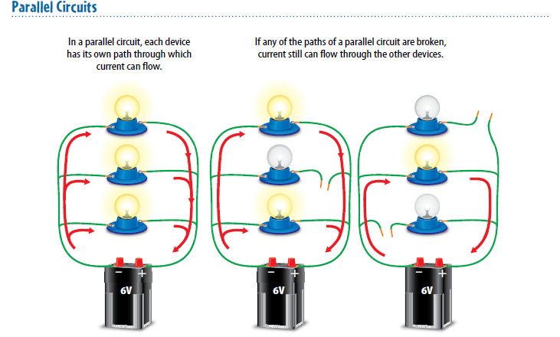
5-18-18 Warm Up 5 minutes
Explain how parallel circuits work.

Slide 2
Today Agenda
1) Warm up 5 minutes
2) Chapter Quiz on Socrative 20 min
3) CK12 content practice 10 min
4) Kahoot 7 min

Slide 3
Chapter Quiz- 20 min
1) You are going to www.socrative.com
2) Click student login
3) Room Name; Berkeley1/Caltech1/Umad/Texasam/Bosphorus
4) Your student ID same as your plicker ID
5) 20 questions total (multiple choice/true or false and 3 short answers)
6) Good luck (If you finish early go to Ck12 for electricity assigment)

Slide 4
CK12- 10 MIN
1) Go to www.ck12.org
2) Click sign in
3) Username;firstnametmsa
Password; tmsa2017
4) You have a 3 assignment

Slide 5
Kahoot
https://play.kahoot.it/#/?quizId=0648a864-3f32-474f-b736-86f2676c2563

