Slide 1
Warm Up 5-7-18 Monday 5 minutes

Slide 2
Warm Up Answer
1.All the cars have wheels that roll over the track, but only the locomotive has an engine to turn the wheels. The other cars are pulled passively behind.
2 Four locomotives have more pulling power than one locomotive. By working together, they can pull a long, heavy train.
3 The ravine occasionally might fill with water, which could wash out the tracks and would make passing through it difficult.

Slide 3
Today Agenda
1) Warm Up 5 minutes
2) Chapter 4 Introduction (Science Journal) 15 minutes
3) Brain Pop- Simple Machine 20 minutes
4) Quizlet Flashcard /Quizlet Live 7 minutes
5) Homework (Simple Machine)

Slide 4
Work and Simple Machines
Chapter Introduction 5/7/18
Lesson 1: Work and Power 5/8/18
Lesson 2: Using Machines 5/9/18
Lesson 3: Simple Machines 5/10/18
Chapter Wrap-Up 5/11/18
Chapter Quiz 5/11/18 Friday
Today notes will be graded. Make sure you write something 0-Nothing 50 incomplete 100 complete

Slide 5
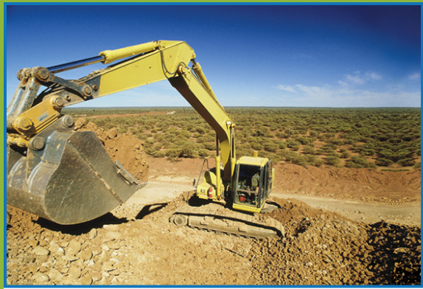
Work and Simple Machines- Write the questions with answer
Hard Work or Not?
Look at the photo at the beginning of the chapter. Digging this hole with a hand shovel would be hard work. Using an earthmover makes the task easier to do. You probably think writing an essay for English class is hard work, but is it?
• What do you think work is?
• How do you think work and energy are related?

Slide 6
Work and Simple Machines- Science Journal
How do machines make doing work easier?
A machine makes work easier by changing the size of the applied force, changing the distance over which the applied force acts, or changing the direction of the applied force.

Slide 7
Work and Simple Machines- Science Journal
Lesson 1: Work and Power
For work to be done on an object, an applied force must move the object in the direction of the force.
When work is done on an object, the energy of the object increases.
Power is the rate at which work is done.

Slide 8
Work and Simple Machines- Science Journal
Lesson 2: Using Machines
A machine can make work easier in three ways: changing the size of a force, changing the distance the force acts, or changing the direction of a force.
The mechanical advantage of a machine is the ratio of the output force to the input force.
Friction between moving parts converts some of the input work into thermal energy and decreases the efficiency of the machine.

Slide 9
Work and Simple Machines- Science Journal
Lesson 3: Simple Machines
A simple machine does work using only one movement.
The ideal mechanical advantage of simple machines is calculated using simple formulas.
A compound machine is made up of two or more simple machines that operate together.

Slide 10
Brain Pop 20 minutes- Chromebook
Work Movie
Work Movie Quiz (review)
Work Map Power
Movie Power
Movie Quiz (review)
Power MapPulley
Movie Pulley
Movie Quiz (review)
Levers Movie
Levers Movie Quiz (review)
Each item is 20 points, you have 20 minutes to finish this assignment.

Slide 11
Quizlet Flashcard/ Live
https://quizlet.com/184380814/work-power-simple-machines-flash-cards/

Slide 12
Homework
Simple Machine 5 question (Reading Article)

