Slide 1
WARM UP 4 MINUTES
8-27-18 MONDAY

Slide 3
ANSWER
1) The eagle is soaring or gliding as it spreads its broad wings and tail
2) How long can the eagle stay in the air before it must rest?
To find the answers to these and other questions, you could research them in books,
3) By studying how animals live, we can take actions to help them survive.

Slide 4
Today Agenda 8/27/18 Monday
1) Warm Up 4 minutes
2) Introduction Scientific Explanations 10 minutes
3 ) Instruction 20 minutes
4) Plicker 10 minutes
5) Homework (Lesson 1 Vocabulary)

Slide 5
Scientific Explanations- Weekly Agenda
Chapter Introduction- Monday
Lesson 1: Understanding Science- Tuesday
Lesson 2: Measurement and Scientific Tools- Wednesday
Lesson 3: Case Study-Chapter Wrap-Up and Lab Activity Thursday
Chapter Quiz (Scientific Method and) Friday / Stem Fair Research

Slide 6
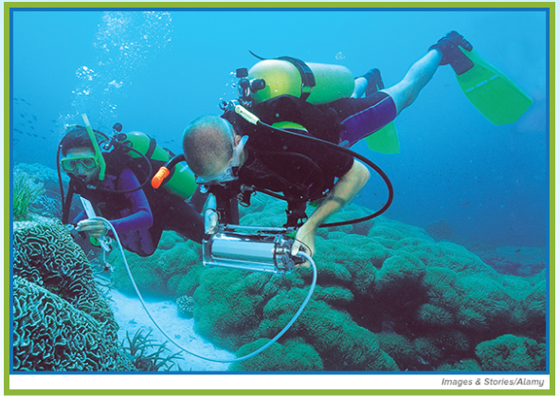
Scientific Explanations-
Vacuuming Corals?
Look at the photo at the beginning of the chapter. These two divers are collecting data about corals in waters near Sulawesi, Indonesia. They are marine biologists, scientists who study living things in oceans and other saltwater environments.
What information about corals are these scientists collecting?
What questions do they hope to answer?
How can science provide answers to their questions and your questions?

Slide 7
Scientific Explanations- Science Journal (with question)
How can science provide answers to your questions about the world around you?
The process of scientific inquiry and performing scientific investigations can provide answers to questions about your world.

Slide 8
Scientific Explanations- Lesson 1 Notes- Science Journal
Lesson 1: Understanding Science
Scientific inquiry, also known as scientific methods, is a collection of skills that scientists use in different combinations to perform scientific investigations.
Scientific investigations often result in new technology, new materials, newly discovered objects or events, or answers to questions.
A scientist can help prevent bias in a scientific investigation by taking random samples, doing blind studies, repeating an experiment several times, and keeping accurate and honest records.

Slide 9
Lesson 1 Vocabulary- 10 min
Hypothesis: possible explanation about an observation that can be tested by scientific investigations
Inference : logical explanation of an observation that is drawn from prior knowledge or experience
Prediction: statement about what will happen next in a sequence of events
scientific law describes a pattern or an event in nature that is always true
scientific theory explanation of observations or events based on knowledge gained from many observations and investigations

Slide 10
Plicker (Check for Understanding)

Slide 11
Homework
Lesson 1 Vocabulary

