Slide 1
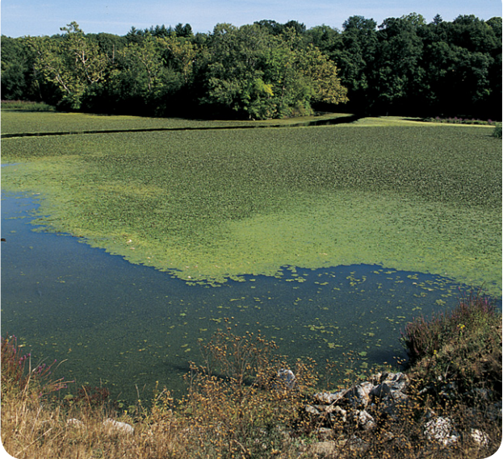
Warm Up 5 minutes 8-30-17 Wednesday
Algae are plantlike organisms. They are used to make animal feed, drugs, and cosmetics. Scientists currently are investigating ways to grow large amounts of algae at a low cost. If they succeed, then algae could be used to make economical fuels for cars and trucks. Describe the algae shown in this photo.
How are algae like plants?
Why are people interested in finding new ways to make fuel?
Why are scientists concerned about the cost of raising algae?

Slide 2
Today Agenda
1) Warm Up 5 minutes
2) Brain Pop 5 minutes
3) Pop Quiz on Kahoot 10 minutes
4) Review First Lesson 5minutes
5) Lesson 2 Lesson Outline/ Vocabulary 15 minutes
6) Review 3 minutes

Slide 3
1
Independent Practice
Answer;

Slide 4
1
Brain Pop Scientific Method
https://www.brainpop.com/science/scientificinquiry/scientificmethod/

Slide 5
1
Understanding Science
Kahoot Pop Quiz

Slide 6
1
Lesson Review- Key Concept Question Answer
Scientific inquiry, also known as the scientific method, is a collection of skills that scientists use in different combinations to perform scientific investigations.
Scientific investigations often result in new technology, new materials, newly discovered objects or events, or answers to questions.
A scientist can help prevent bias in a scientific investigation by taking random samples, doing blind studies, repeating an experiment several times, and keeping accurate and honest records.

Slide 7
2
Measurement and Scientific Tools
What is the difference between accuracy and precision?
Why should you use significant digits?
What are some tools used by scientists?

Slide 8
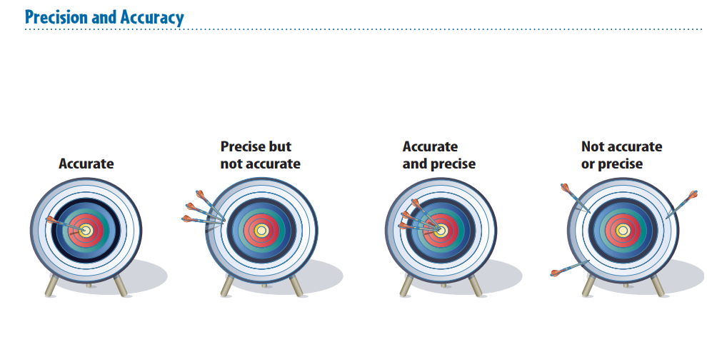
Difference Between Precision And Accuracy

Slide 9
Lesson 2 Course Outline

Slide 10
Vocabulary – Lesson 2 Measurement
accuracy description of how close a measurement is to an accepted or true value
description spoken or written summary of observations
digital of, pertaining to, or using numbers (numerical digits)
explanation interpretation of observations
International System of Units (SI) internationally accepted system for measurement
precision description of how similar or close measurements are to each other
significant digits number of digits in a measurement that are known with a certain degree of reliability

Slide 11
2
Measurement and Scientific Tools
What is the difference between accuracy and precision?
Precision is a description of how similar or close measurements are to each other. Accuracy is a description of how close a measurement is to an accepted value.

Slide 12
2
Measurement and Scientific Tools
Why should you use significant digits?
Significant digits communicate the precision of the tool used to make measurements.

Slide 13
2
Measurement and Scientific Tools
What are some tools used by scientists?
Life scientists use many tools, such as science journals, microscopes, computers, magnifying lenses, slides, and dissecting tools.

