Slide 1
Homework Check
1. Sample answer: A description summarizes an observation. An explanation tells how an observation is interpreted.
2. Sample answer: The International System of Units allows scientists who work in different parts of the world
3. x = 1.892 kg
4)Accuracy is a description of how close a measurement is to an accepted value; precision is a description of how similar or close separate measurements are to each other
5) There are 6 significant digits in this number. The digits 3, 9, 2, and 1 are significant and 0.

Slide 2
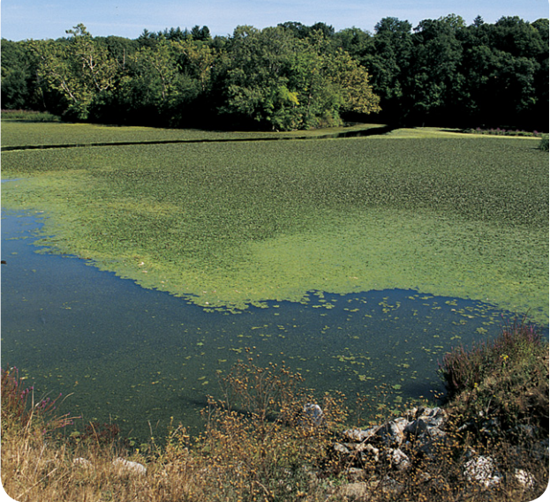
Warm Up 5 minutes 8-30-18 Thursday
Algae are plantlike organisms. They are used to make animal feed, drugs, and cosmetics. Scientists currently are investigating ways to grow large amounts of algae at a low cost. If they succeed, then algae could be used to make economical fuels for cars and trucks. Describe the algae shown in this photo.
How are algae like plants?
Why are people interested in finding new ways to make fuel?
Why are scientists concerned about the cost of raising algae?

Slide 3
Today Agenda
1) Warm Up 4 min
2) Lesson Notes 5 min
2) Flinn Lab Safety Agreement 5 min
3) Lab Equipment Classwork 10 min
4) Penny Drop Lab Activity 20 min

Slide 4
Scientific Explanations- Science Journal
Lesson 3: Case Study: Biodiesel from Microalgae
The independent variable is a factor in an experiment that is manipulated or changed by the investigator to observe how it affects a dependent variable. The dependent variable is the factor measured or observed during an experiment.
Scientific inquiry is used to gain information and find solutions to real-life problems and questions.

Slide 5
1
Lab Equipment/ Lab Safety
Flinn Lab Safety Agreement
Lab Equipment
Penny Drop Activity

Slide 6
Answer
Tongs
Googles
Beaker
Test Tube
Triple Beam Balance
Lab coat or Apron
Eye dropper
Striker
Ring Clamp
Graduated Cylinder
Lab Stand
Funnel
Bunsen Burner
Erlenmeyer flask

Slide 7
1
Water Droplet Experiment
YouTube Tutorial

