Slide 1
Warm Up 5 minutes 9-12-17 Tuesday
Name what are the layers of the atmosphere?
Answer; starting from Earth: troposphere, stratosphere, mesosphere, thermosphere, exosphere

Slide 2
Today Agenda
1) Warm up 5 minutes
2) Homework Check 5 minutes
3) Read to Learn 5 minutes
4) After read 5 minutes
5) Dependent Practice Lesson 13 minutes
6) Kahoot 10 minutes

Slide 3
Read To learn
12. Explain How does air pressure change as altitude increases?
decreases as altitude increases
13) Explain How does temperature change as altitude increases?
As altitude increases, temperature decreases in the troposphere, increases in the stratosphere, decreases in the mesosphere, and increases in the thermosphere and exosphere.
14)Identify Which layer has a temperature pattern most like the troposphere’s?
mesosphere

Slide 4
After You Read
1) Write a sentence explaining why the ionosphere has that name.
The ionosphere contains electrically charged particles, called ions.
2)Use what you have learned about the layers of Earth’s atmosphere to complete the table.

Slide 5
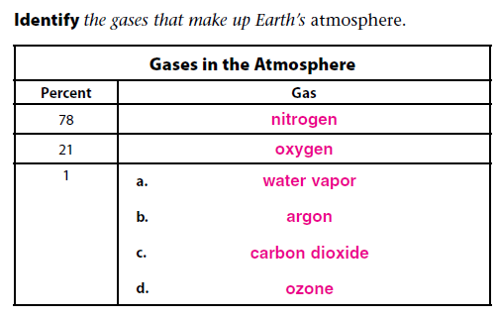
Details Page 199
Assess; False; invisible and True
Identify;

Slide 6
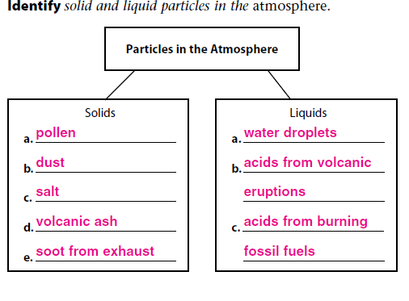
Details 199
Identify;

Slide 7
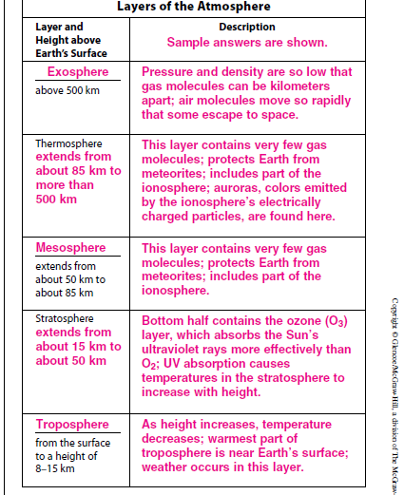
Describe the layers of the atmosphere .

Slide 8
Distinguish

Slide 9
Identify and Explain Page 201

Slide 10
Identify and Connect it.

Slide 11
Homework

Slide 12
Kahoot
https://play.kahoot.it/#/?quizId=939984c5-833c-4378-ab89-e048b022fbb3

