Slide 1
Warm Up 5 minutes 9-18-17 Monday
Reading Content
Questions
Hundreds of years ago, tall sailing ships carried goods and passengers across the oceans. Winds filled the billowing sails to power these ships on their journeys. Ship captains knew that ocean winds blow in patterns. They plotted courses that took advantage of bands of strong winds.
1)What is wind? What can wind do?
2 What types of winds blow where you live? Do they form a pattern of any kind? Discuss.
3) A system is made of many parts that interact. Are winds part of a system? Explain.

Slide 2
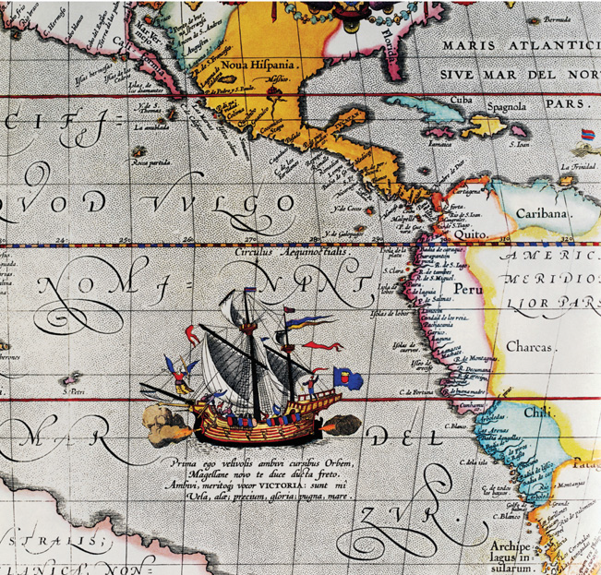
Answer Key
Answer
Picture
1)Wind is moving air. Wind can power sailboats, lift a kite, and spin wind turbines, which are used to generate electricity. Strong winds can topple trees.
2 Answers will vary with location. Most places receive a variety of winds, including calm winds, strong winds, and winds that are part of severe storms. Wind patterns often are named, such as nor’easters and Santa Ana winds, or they can be part of severe storms, such as hurricanes and tornados.
3 Yes. Winds blow across Earth’s surface, and winds in one region affect winds elsewhere. Earth’s atmosphere forms a system that surrounds and affects the entire planet.

Slide 3
Today Agenda
1) Warm Up 5 minutes
2) Text Book distribution 10 minutes
3) Experiment Soda Can Crush 15 minutes
4) Read to Learn Lesson 3 Air Current
5) Classwork

Slide 4
Text Book Introduction
1) Student should agree you are not allowed to write anything in these textbook.
2) If you realize someone is using your textbook , make sure you warn the teacher. That’s your responsibility keep eye on them.
3) When you received your book look through pages 188- to 210.

Slide 5
Air Pressure Can Crush
1) Video
2) Worksheet

Slide 6
Text Book to Science Journal
Key Concepts (write 3 questions on your science journal
Key Concept Check/Reading Check questions with your answer
Vocabulary highlighted
Foldable

Slide 7
3
Air Currents

Slide 8
3
Air Currents
Uneven heating in different parts of the atmosphere creates air circulation patterns.
Warm air sinks and cold air rises.

Slide 9
3
Air Currents
How does uneven heating of Earth’s surface result in air movement?
How are air currents on Earth affected by Earth’s spin?
What are the main wind belts on Earth?

Slide 10
3
Air Currents
wind
trade winds
westerlies
polar easterlies
jet stream
sea breeze
land breeze

