Slide 1
Warm Up 4 min 9-24-18 Monday

Slide 2
Warm Up Answer
The location where the tornado strikes, the severity and duration of the storm, and how well people are prepared for the tornado.
Hurricanes, thunderstorms, and blizzards.
Experts advise seeking shelter immediately in a low place. Do not try to outrun an approaching tornado.

Slide 3
Today Agenda
1) Warm Up 4 minutes
2) Content Practice 15 minutes (Lesson 1)
3) Quizlet Practice (Weather Pattern) 15 min (Lesson 2- Vocabulary Practice)
4) Quizlet Live 10 min (Donut Reward)
6) Homework (Lesson Vocabulary 2)

Slide 4
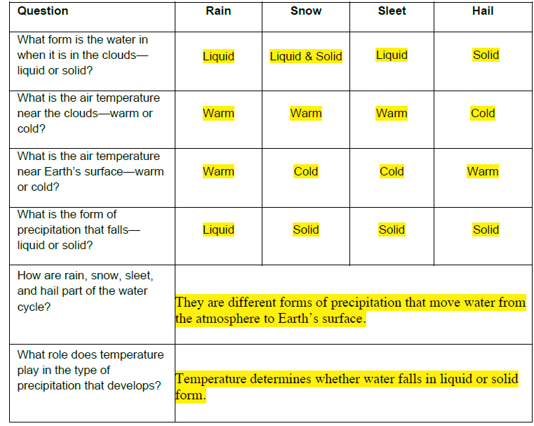
Content Practice A

Slide 5
Content Practice B
1) Air Temperature; Air temperature determines whether precipitation falls as a liquid (rain) or a solid
2) Air pressure is used to predict weather.
3) Wind indicates direction and a change in air pressure.
4) Humidity indicates the amount of moisture in the air and, thus, directly relates to the potential for precipitation

Slide 6
Content Practice B
5) relative humidity is used to predict the possibility of precipitation
6) Dew point indicates the temperature at which precipitation will form
7) The height and type (shape) of cloud are used to predict the type of weather that is possible
8) Fog is clouds that form near Earth’s surface, so it reduces visibility

Slide 7
Content Practice B
9) Precipitation falls as rain, snow, sleet, or hail.
10) The type of weather that a region experiences depends on what is happening at that place in the water cycle.
11) If water is evaporating and the humidity levels are low, then there is no precipitation
12) If water vapor condenses and clouds form, then precipitation will fall.

Slide 8
Go to www.quizlet.com
1) Click search part and type Weather Pattern- TMSA
2) You are going to flashcard, learn and take the test and tell me your score.

Slide 9
Quizlet Live
https://quizlet.com/318372168/weather-pattern-tmsa-flash-cards/?new
The team who won the competition will get a donut.

Slide 10
Homework
Lesson 2 Vocabulary

