Slide 1
Warm Up 5 minutes
What variables do meteorologists use to describe weather?.
The variables include air temperature, air pressure, wind speed and direction, humidity, cloud coverage, and precipitation.
2. What tool is used to measure air pressure?
A barometer measures air pressure.

Slide 2
Today Agenda
1) Warm Up 5 minutes/Homework Collection
2) Lesson 2 Weather Pattern Introduction
3) Essential Questions
4) Vocabulary
5) Brain Pop
6) Plicker-Pop Quiz

Slide 3
2
Weather Patterns

Slide 4
2
Weather Patterns
Precipitation often occurs at the boundaries of large air masses.
There are no safety precautions for severe weather such as tornadoes and hurricanes.
Agree.
Disagree. Weather watches and warnings are broadcast on radio and television.

Slide 5
Weather
Lesson 2: Weather Patterns
Low-pressure systems and high-pressure systems are two systems that influence weather.
Weather patterns are driven by the movement of air masses.
Understanding weather patterns helps make weather forecasts more accurate.
Severe weather includes thunderstorms, tornadoes, hurricanes, and blizzards.

Slide 6
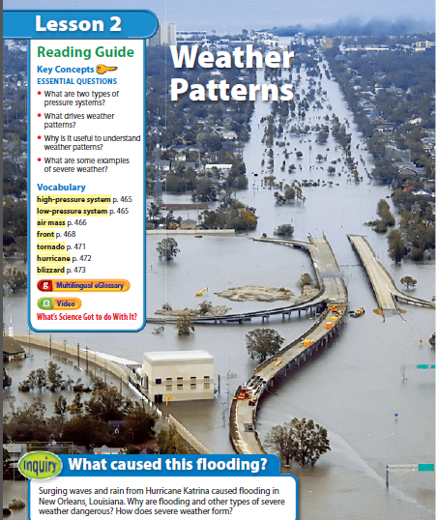
What caused this flooding?
Weather Patterns
Look at the photo at the beginning of the lesson. Surging waves and rain from Hurricane Katrina caused flooding in New Orleans, Louisiana. Why are flooding and other types of severe weather dangerous? How does severe weather form?
2

Slide 7
2
Weather Patterns
What are two types of pressure systems?
What drives weather patterns?
Why is it useful to understand weather patterns?
What are some examples of severe weather?

Slide 8
Key Concept Question Answer
1) Low-pressure systems and high-pressure systems are two systems that influence weather.
2) Weather patterns are driven by the movement of air masses.
3) Understanding weather patterns helps make weather forecasts more accurate.
4)Severe weather includes thunderstorms, tornadoes, hurricanes, and blizzards.

Slide 9
2
Weather Patterns
low-pressure system
high-pressure system
air mass
front
tornado
hurricane
blizzard

Slide 10
Lesson 2 -Vocabulary
low-pressure system large body of circulating air that has low pressure at its center and higher pressure on the outside
high-pressure system large body of circulating air that has high pressure at its center and lower pressure on the outside
air mass large body of air with distinct temperature and moisture characteristics
front boundary between two air masses
tornado violent, whirling column of air that comes in contact with the ground
hurricane intense tropical storm with winds exceeding 119 km/h
blizzard violent winter storm characterized by freezing temperatures, strong winds, and blowing snow

Slide 11
Brain Pop Video
1) Video 1 –What is weather
2)Plicker
3) Video 2 – Cloud
4) Plicker

