Slide 1
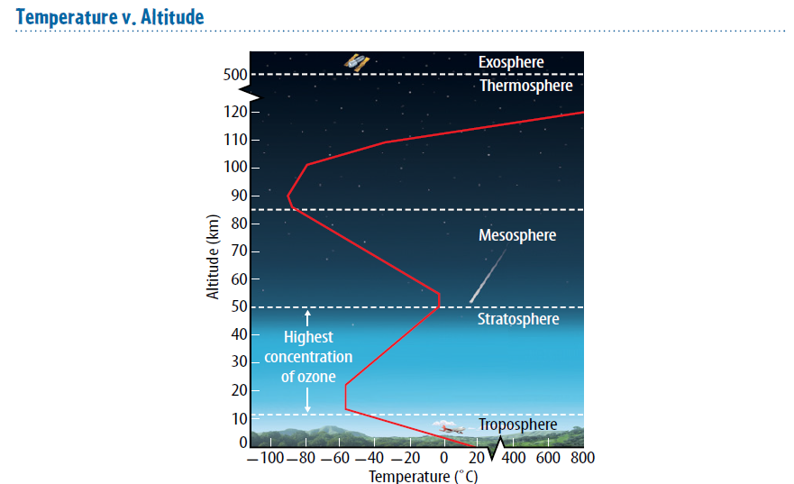
Warm up 4 min 9-5-18 Wednesday 1)Explain what causes temperature difference in the atmosphere.

Slide 2
Warm Up Answer
Temperature differences among the layers are due in part to differences in air pressure and gas concentrations.

Slide 3
Today Agenda
1) Warm Up 4 min
2) Lesson 1 Vocabulary 5 min
3) Lesson Outline 10 min
4) Video and Classwork 15 min
5) Homework (School to Home Lesson 1)

Slide 4
Vocabulary 5 minutes
Atmosphere thin layer of gases surrounding Earth
ionosphere region within the mesosphere and thermosphere containing ions
liquid matter with a definite volume but with no definite shape
ozone layer area of the Stratosphere with a high concentration of ozone
stratosphere atmospheric layer directly above the troposphere
troposphere atmospheric layer closest to Earth’s surface
water vapor gaseous form of water

Slide 5
Lesson 1: Earth’s Atmosphere Lesson Outline
A. Importance of Earth’s Atmosphere
1. The atmosphere is a thin layer of gases surrounding Earth. It is hundreds of kilometers high.
2. Earth’s atmosphere contains a layer of insulation that helps keep temperatures on Earth within a range that living organisms can survive.
3. Earth’s atmosphere helps protect living organisms from some of the Sun’s harmful rays.
4. Friction within the atmosphere causes most meteors to burn up before striking Earth.
B. Origins of Earth’s Atmosphere
1. Earth’s ancient atmosphere formed from hot gases that escaped from Earth’s hardening surface.
2. Earth’s ancient atmosphere consisted of water vapor with a little bit of carbon dioxide.
3. Water vapor is water in its gaseous state.
4. As Earth’s atmosphere cooled, the water vapor condensed into a(n) liquid that fell as rain. Over thousands of years, the rain formed Earth’s oceans.
5. Carbon dioxide from the atmosphere dissolved in rainwater and fell into the oceans.
6. Organisms that use photosynthesis produced the oxygen in today’s atmosphere.

Slide 6
C. Composition of the Atmosphere
1. Nitrogen makes up about 78 percent of Earth’s atmosphere.
2. Oxygen makes up about 21 percent of Earth’s atmosphere.
3. The amounts of atmospheric gases, which include water vapor, carbon dioxide, and ozone vary.
4. Volcanoes send solid particles and liquid acids into the atmosphere.
D. Layers of the Atmosphere
1. The atmospheric layer closest to Earth is the troposphere.
2. The warmest part of the troposphere is near Earth’s surface.
3. The stratosphere is the atmospheric layer directly above the troposphere.
4. The area of the stratosphere that has a great amount of ozone gas is the ozone layer.
5. Ultraviolet rays, which can kill plants and animals, are absorbed more effectively by ozone than by oxygen gas.
6. Combined, the mesosphere and the thermosphere are layers of the atmosphere that are much broader than the troposphere and the stratosphere. They have a low density of gases.
7. The ionosphere is a region within the mesosphere and troposphere that contains ions. Displays of colored lights called auroras occur here.
8. In the exosphere, gas molecules rarely strike one another.

Slide 7
E. Air Pressure and Altitude
1. Gravity pulls gas particles in the atmosphere toward Earth’s surface.
2. Air pressure is greatest near Earth’s surface because all the molecules of the atmosphere push downward on the lowest layer of air.
F. Temperature and Altitude
1. In the troposphere, temperature decreases as altitude increases. The opposite occurs in the next layer up, the stratosphere.
2. In the mesosphere, temperature decreases as altitude increases. In the thermosphere and exosphere, the opposite happens.

Slide 8
Content Practice (Independent)
10 min
5 min Content Practice A 5 min Content Practice B

Slide 9
Video and Plicker
Video

Slide 10
Homework
School to Home Lesson 1

