Slide 1
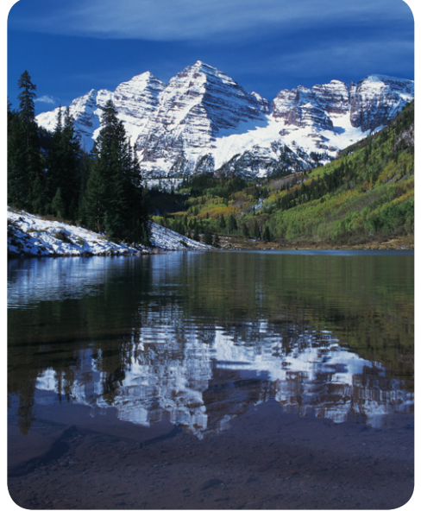
9-7-17 Thursday Warm Up 5 minutes
1) Regardless of the season, be sure to bring warm clothes on a hiking trip to western Colorado. Temperatures can drop suddenly. Even when temperatures are warm in the valley, they can be extremely cold in the mountains. When climbers scale the mountains shown here, they often carry oxygen tanks with them. The air is both thin and cold at altitudes of 4,300 m (14,000 ft) and higher.
QUESTIONS
1)Compare snowcover on the mountain to snowcover by the lake.
2 Would you expect air to be colder at the altitude of clouds than it is on Earth’s surface? Discuss.

Slide 2
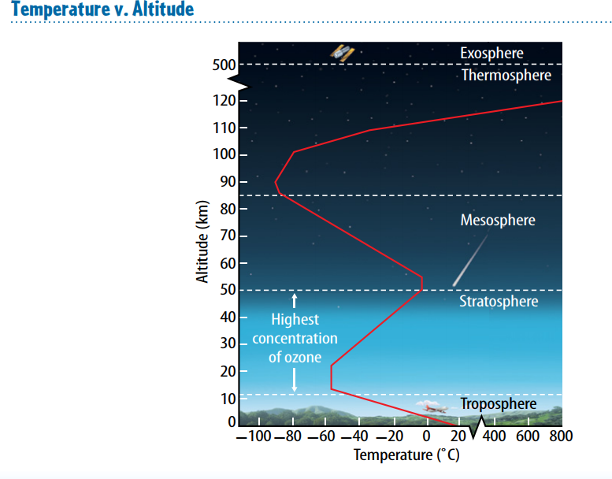
Focus On content
You are thinking the outer layers of the atmosphere are closer to the Sun than the inner layers, and that this is why temperature varies among the layers.
This reasoning is not correct. The Sun is approximately 150 million kilometers away from Earth, and the thickness of the atmosphere is extremely small in comparison.

Slide 3
Today Agenda
1) Warm up 5 minutes
2) Homework Check 5 minutes
3) Introduction of New Unit 5 minutes
4) Lesson 1 Describing Earth Atmosphere 25 minutes

Slide 4
Earth’s Atmosphere
Chapter Introduction
Lesson 1: Describing Earth’s Atmosphere
Lesson 2: Energy Transfer in the Atmosphere
Lesson 3: Air Currents
Lesson 4: Air Quality
Chapter Wrap-Up

Slide 5
Earth’s Atmosphere
How does Earth’s atmosphere affect life on Earth?

Slide 6
Earth’s Atmosphere
What’s in the atmosphere?
Look at the photo at the beginning of the chapter. Earth’s atmosphere is made up of gases and small amounts of liquid and solid particles. Earth’s atmosphere surrounds and sustains life.
What type of particles make up clouds in the atmosphere?
How do conditions in the atmosphere change as height above sea level increases?
How does Earth’s atmosphere affect life on Earth?

Slide 7
1
Earth’s Atmosphere
Why is the atmosphere important?
Earth’s surface would be scarred with craters created from the impact of meteorites. Earth would experience extreme daytime-to-nighttime temperature changes.
How would changes in the atmosphere affect life?
What effect would atmospheric changes have on weather and climate?

Slide 8
Earth’s Atmosphere
How does Earth’s atmosphere affect life on Earth?
The gases in Earth’s atmosphere, some of which are needed by organisms to survive, affect Earth’s temperature and the transfer of thermal energy to the atmosphere.

Slide 9
Earth’s Atmosphere
Lesson 1: Describing Earth’s Atmosphere
Earth’s atmosphere formed as Earth cooled and chemical and biological processes took place.
Earth’s atmosphere consists of nitrogen, oxygen, and a small amount of other gases, such as CO₂ and water vapor.
The atmospheric layers are the troposphere, the stratosphere, the mesosphere, the thermosphere, and the exosphere.
Air pressure decreases as altitude increases. Temperature either increases or decreases as altitude increases, depending on the layer of atmosphere.

Slide 10
1
Earth’s Atmosphere
Air is empty space.
Earth’s atmosphere is important to living organisms.

Slide 11
1
Earth’s Atmosphere
How did Earth’s atmosphere form?
What is Earth’s atmosphere made of?
What are the layers of the atmosphere?
How do air pressure and temperature change as altitude increases?

Slide 12
1
Earth’s Atmosphere
atmosphere
water vapor
troposphere
stratosphere
ozone layer
ionosphere

Slide 13
1
Earth’s Atmosphere
Air is empty space.
Disagree. Air is made of molecules that have mass and take up space.

Slide 14
1
Earth’s Atmosphere
Earth’s atmosphere is important to living organisms.
Agree. Air is needed by both plants and animals.

